Slide 1




SECRETARY’S CLASS- SESSION 1

Slide 2

INTRODUCTIONS
YOUR NAME?
YOUR VOICE PART?
THE CHAPTER YOU REPRESENT?
# OF YEAR’S IN THE SOCIETY?
WHY YOU TOOK THE JOB?

Slide 3
BY THE END OF TODAY EACH CHAPTER SECRETARY WILL BE ABLE TO:
DEMONSTRATE HOW TO NAVIGATE THE WWW.BARBERSHOP.ORG WEB SITE AND LOCATE DOCUMENTS AND FORMS.
DEMONSTRATE THE PROCESS OF COMPLETING AND SUBMITTING THE MEMBERSHIP & TRANSFER APPLICATION FORM.
DESCRIBE THE FACTORS DETERMINING THE CORRECT MEMBERSHIP CLASSIFICATION.
DESCRIBE THE SHOW CLEARANCE AND LICENSING PROCESS.
DESCRIBE THE NEED AND CLAIM PROCESS FOR LIABILITY/BONDING INSURANCE.
OUTLINE THE LEGAL DOCUMENTS THAT SHOULD BE STORED BY EACH CHAPTER.
DESCRIBE THE REASONS WHY THE YOUTH POLICY AND INCORPORATION ARE NEEDED.
DESCRIBE THE VARIOUS ROLES OF THE CS IN EFFICIENT CHAPTER OPERATION.
OUTLINE THE CS PRIORITIES AND PROPER RELATIONSHIPS WITH THE CP AND CT.
OUTLINE THE PROCESS FOR TRANSFERRING TO A NEW CHAPTER.
IDENTIFY THE QUALITIES OF A LEADER.
IDENTIFY THE WAYS A CS CAN BE AN EFFECTIVE CHAPTER LEADER.
DESCRIBE THE FOUR DIFFERENT EASY DUES PLANS AVAILABLE TO THE MEMBERS.
OUTLINE HOW A CHAPTER ROSTER CAN BE GENERATED BY USING THE SOCIETY WEB SITE.
DISCUSS AND DEMONSTRATE THE FUNDAMENTALS.

Slide 4

LEADERSHIP VS. MANAGEMENT
LEADERSHIP
INSPIRES A SHARED VISION
PROVIDES A PURPOSE
PROMOTES VALUES
CREATES CHANGE
CREATES AN ENVIRONMENT WHERE PEOPLE CAN MOTIVATE THEMSELVES
CHALLENGES THE PROCESS
MODELS THE WAY
ENCOURAGES THE HEART
MANAGEMENT
PLANS
ORGANIZES
PRODUCES ORDERS
IMPLEMENTS SYSTEMS
CONFORMS TO GOALS
CONTROLS
ALLOCATES RESOURCES
FOCUSES EFFORTS

Slide 5

ROLE OF THE CHAPTER SECRETARY
SERVES AS THE BUSINESS MANAGER FOR THE CHAPTER
MAINTAINS AND UPDATES ALL CHAPTER MEMBERSHIP RECORDS
ORDERS CHAPTER SUPPLIES AND MERCHANDISE

Slide 6

ROLE OF THE CHAPTER SECRETARY
REGISTERS OTHERS IN THE CHAPTER FOR SCHOOLS, CONTESTS
AND OTHER DISTRICT AND SOCIETY SPONSORED ACTIVITIES
MAKES SURE THE CHAPTER STAYS LEGAL AND MAINTAINS LEGAL FILES
HANDLES LICENSING PAPERWORK AND CLEARANCES FOR SHOWS

Slide 7

ROLE OF THE CHAPTER SECRETARY
COMMUNICATES WITH ALL LEVELS OF THE SOCIETY
PROVIDES LEADERSHIP AND IS AN ACTIVE PARTICIPANT IN CHAPTER MEETINGS AND ACTIVITIES
ASSISTS THE CHAPTER TREASURER AND HELPS TO KEEP THE CHAPTER FINANCIALLY IN THE BLACK

Slide 8

ROLE OF THE CHAPTER SECRETARY
STRIVES TO KEEP OTHER CHAPTER OFFICERS ON TASK
PROVIDES “BEHIND THE SCENES” OPERATIONAL SUPPORT SO OTHER MEMBERS CAN ENJOY THEIR HOBBY TO THE FULLEST
HANDLES THE ANNOUNCING, WRITING AND DISTRIBUTION OF MINUTES FOR ALL CHAPTER MEETINGS

Slide 9

SECRETARY’S YEARLY SCHEDULE
(SEE PAGE 6 CHAPTER SECRETARY MANUAL FOR ADDITIONAL DETAILS)
MONTHLY
PROCESSES ALL MEMBERSHIP APPLICATIONS AND DISTRIBUTE MEMBERSHIP CARDS AND ITEMS TO NEW MEMBERS
PROCESSES DUAL MEMBERSHIP AND TRANSFER REQUESTS
VERIFIES SOCIETY INVOICES WITH TREASURER
ANNOUNCES CHAPTER BOARD MEETING
WRITES, PUBLISHES, AND DISTRIBUTES MEETING MINUTES
NOTIFIES MEMBERS OF MONTHLY RENEWAL
NOTIFIES CHAPTER DEVELOPMENT OFFICER OF MEMBERS FAILING TO RENEW THEIR MEMBERSHIP.
DISTRIBUTES RENEWED MEMBERSHIP CARDS

Slide 10
SECRETARY’S YEARLY SCHEDULE
(SEE PAGE 6 CHAPTER SECRETARY MANUAL FOR ADDITIONAL DETAILS)
ANNUALLY
JAN – BONDED MEMBERS IN MINUTES, REMIND CP TO APPOINT NOMINATING AND FINANCIAL REVIEW COMMITTEES
MAR – CONTEST ENTRY FOR SPRING CONTEST
APR – VERIFY CONTINUED EXISTENCE CERTIFICATE (INCORPORATION) AND FEE TO STATE, SHARE INFO ON INTERNATIONAL
MAY – VERIFY AUDIT AND IRS 990 FORMS FILED (IN U.S.) BY CHAPTER TREASURER
AUG – CONTEST ENTRY SUBMITTED
OCT – HOLD CHAPTER ELECTIONS, COMPLETE CHAPTER LEADERSHIP REPORT TO SOCIETY, COMPLETE CHAPTER OFFICER REGISTRATION TO COTS
FILE SHOW CLEARANCE (BMI/ASCAP IN U.S) FORMS

Slide 11

ROBERT’S RULES OF ORDER
ROBERT’S RULES OF ORDER (REVISED) IS AN EXCELLENT RESOURCE TO ASSIST YOUR
CHAPTER IN RUNNING THEIR BUSINESS MEETINGS
-- HOWEVER --
YOUR MEETINGS DO NOT NEED TO FOLLOW STRICT PARLIAMENTARY PROCEDURES (FOUND IN ROBERT'S RULES OF ORDER) TO BE RUN EFFECTIVELY.

Slide 12
PROCEDURES IN SMALL BOARDS
EXCERPT FROM ROBERT’S RULES OF ORDER
“In a board meeting where there are not more than about a dozen members present, some of the formality that is necessary in a large assembly would hinder business. The rules governing such meetings are different from the rules that hold in other assemblies, in the following respects:
1. Members are not required to obtain the floor before making motions or speaking, which they can do while seated.
2. There is no limit to the number of times a member can speak to a question, and motions to close or limit debate generally should not be permitted.
3. Informal discussion of a subject is permitted while a motion is pending.
4. The chairman need not rise while putting question to vote.
5. The chairman can speak in discussion without rising or leaving the chair; and, subject to
rule or custom within the particular board (which should be uniformly followed regardless
of how many members are present), he usually can make motions and usually votes on all
questions.
6. Sometimes, when a proposal is perfectly clear to all present, a vote can be taken without a
motion’s having been introduced. Unless agreed to by unanimous consent, all proposed
actions of a board must be approved by vote under the same rules as in other assemblies,
except that a vote can be taken initially by a show of hands, which is often a better method
in such meetings

Slide 13
To Limit Debate
When members of the assembly call out informally, “Question! Question!”, it means only that they as individuals are ready to vote on the pending question or motion. This informal “call for the question” by members must be clearly differentiated from the formal motion “to close debate and vote immediately on the pending question”, (or what is exactly the same) the formal “I move the previous question”.
To Close Debate
“I move the previous Question” is the old, brief way of moving to close debate.
The current formal way of closing debate is “I move that we close debate and vote
immediately on the pending question”. Requires a second.
Is not debatable nor can it have a subsidiary motion to amend.
Requires a two-thirds vote to pass.
NOTE: Copies of Roberts Rules of Order are available at most book stores. It is recommended
the Chairman have a copy of “Parliamentary Procedure at a glance”.

Slide 14
ROBERT’S RULES OF ORDER
USE CONSENSUS, RATHER THAN MOTIONS, WHENEVER POSSIBLE
USE MOTIONS, IN WRITING, WHEN DEALING WITH ALL MONEY MATTERS
IT’S UNNECESSARY TO LIST MAKERS OF A MOTION AND SECOND OR VOTING
RESULTS, UNLESS A ROLL CALL VOTE IS CALLED FOR OR A DISSENTING VOTE
WANTS TO HAVE HIS VOTE RECORDED IN THE MINUTES
INSIST ON WRITTEN REPORTS FROM CHAPTER VICE-PRESIDENTS OR
COMMITTEE CHAIRMEN; DELIVERED WELL IN ADVANCE OF THE MEETING
ALWAYS PUBLISH THE AGENDA AHEAD OF THE MEETING (A WEEK IF POSSIBLE)

Slide 15

WHY USE PARLIAMENTARY PROCEDURES?
PARLIAMENTARY PROCEDURES ALLOW FOR…
EVERYONE TO BE HEARD AT A MEETING
A DECISION-MAKING PROCESS WITHOUT CONFUSION
A FAIR HEARING OF AN ISSUE/MOTION
FLEXIBILITY TO ADDRESS MOST MEETING SITUATIONS
PROTECTION OF THE RIGHTS OF EVERYONE
DEMOCRATIC PROCESS AT MEETINGS

Slide 16

QUORUM
A QUORUM IS THE MINIMUM NUMBER OF OFFICERS OR MEMBERS REQUIRED AT A MEETING IN ORDER TO CONDUCT BUSINESS
AT CHAPTER BOARD MEETING
50% (OR MORE) OF VOTING OFFICERS PRESENT
AT ANNUAL MEMBERSHIP MEETING
30% (OR MORE) OF ALL GENERAL MEMBERSHIP PRESENT

Slide 17

TYPES OF MOTIONS
MAIN MOTIONS
SUBSIDIARY MOTIONS
- AMENDMENTS TO THE MOTION
- MOTIONS TO TABLE
PRIVILEGED MOTIONS
- PERSONAL PRIVILEGE
- POINT OF ORDER
INCIDENTAL MOTIONS
MOTIONS TO RECONSIDER
- REQUIRES 2/3 MAJORITY AND SPECIAL REQUIREMENTS TO RECONSIDER

Slide 18
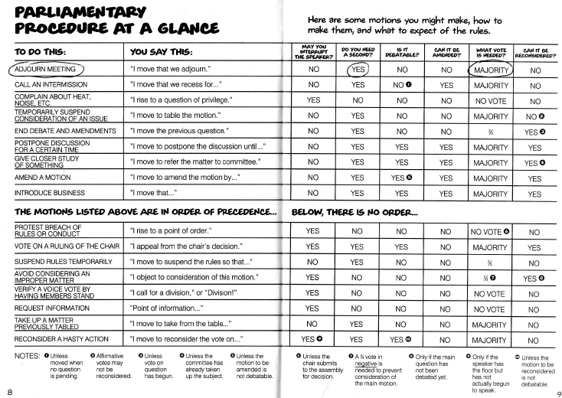
ROBERT’S RULES CHEAT SHEET

Slide 19

YOUR ROLE AT CHAPTER BOARD MEETINGS
YOU ARE THE RECORDING SECRETARY AND YOU TAKE MINUTES.
YOU ARE THE VOICE OF REASON AND PROCEDURES.
YOU REPRESENT THE MEMBERS AND HAVE A VOICE IN DELIBERATIONS.
YOU ARE THE MAN “IN THE KNOW”.
YOU ACCURATELY SHARE INFORMATION WITH THE MEMBERS.
YOU SHARE INFORMATION FROM THE DISTRICT AND SOCIETY.
YOU WORK CLOSELY WITH THE CHAPTER PRESIDENT AND TREASURER.

Slide 20

MEETING RESPONSIBILITIES
BEFORE THE MEETING
ANNOUNCE TO THE MEMBERSHIP THAT THE MEETING WILL TAKE PLACE, ITS TIME AND LOCATION.
DESIGN AND PUBLISH THE AGENDA WITH THE CHAPTER PRESIDENT
SEEK INPUT FROM THE CHAPTER MEMBERSHIP.
COPY AND MAKE AVAILABLE ALL DOCUMENTS AND REPORTS NEEDED FOR THE MEETING.
PREPARE A MEMBERSHIP STATUS REPORT.

Slide 21

MEETING RESPONSIBILITIES
DURING THE MEETING
RECORD ACCURATE MINUTES.
PROVIDE INPUT DURING MEETING DISCUSSIONS.
AFTER THE MEETING
PROMPTLY PREPARE AND PUBLISH MINUTES.
SHARE THE MINUTES AND INFORMATION WITH THE BULLETIN EDITOR.
ANSWER QUESTIONS COMING FROM THE CHAPTER MEMBERSHIP.

Slide 22
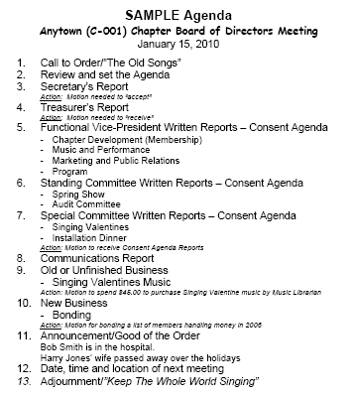


Slide 23
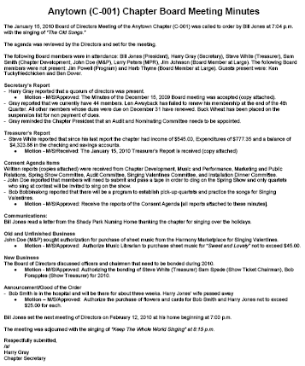


Slide 24
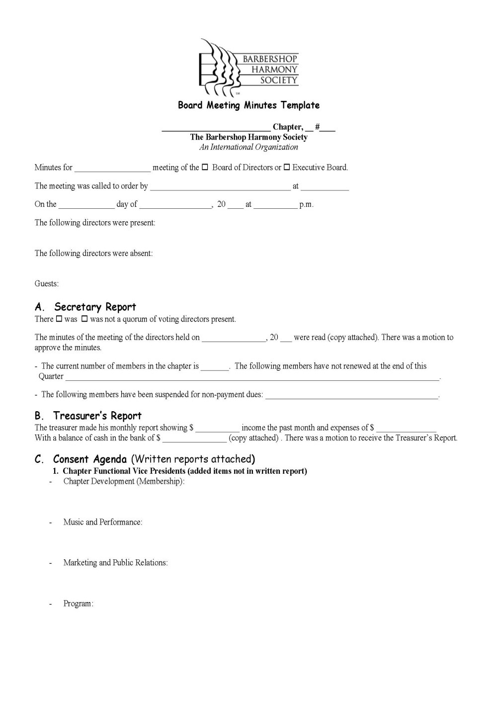
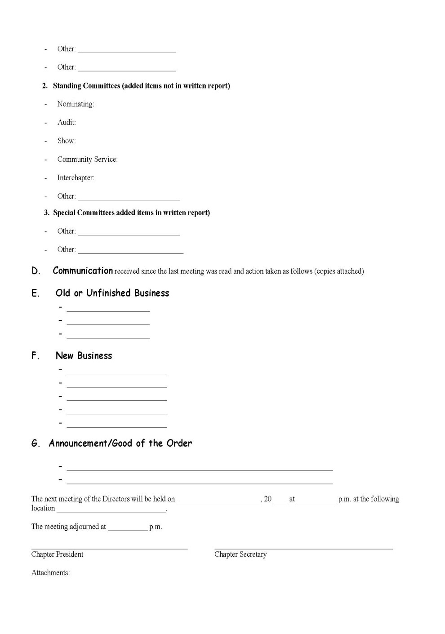

Slide 25

MEMBERSHIP & TRANSFER FORM
IS A ONE SHEET/ONE SIDED FORM;
HANDLES ALL APPLICATIONS FOR REGULAR, SENIORS, STUDENT, DUAL AND TRANSFER MEMBERSHIPS; AND,
WILL HELP TO LEAD THE WAY FOR ONLINE APPLICATION PROCESSING IN THE FUTURE WITH APPLICATION FEES PAID USING A CREDIT CARD.

Slide 26
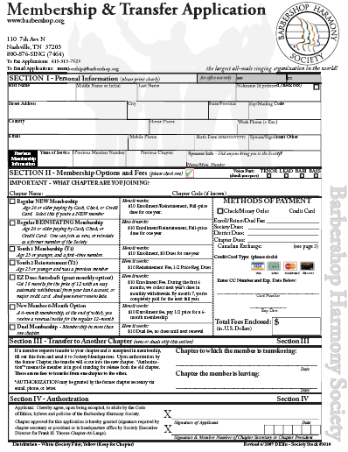
COMBINED PURPOSE
APPLICATION FORM
NEW/DUAL MEMBER…
COMPLETE SECTIONS I, II, & IV
TRANSFER MEMBER…
COMPLETE SECTIONS I, III & IV
NO FEES REQUIRED
TIPS:
NEATNESS COUNTS… PRINT OR TYPE
BE ACCURATE WITH INFORMATION
BE COMPLETE
EXPLORE PAYMENT OPTIONS WITH APPLICANT
SIGN THE APPLICATION (APPLICANT AND CHAPTER SECRETARY)
ALWAYS MAKE A COPY FOR CHAPTER RECORDS
FILE IN AN ORGANIZED WAY
SEND TO SOCIETY IMMEDIATELY WITH FEES
FOLLOW-UP IF NO RESPONSE (A PHONE CALL) FROM THE SOCIETY MEMBERSHIP DEPARTMENT WITHIN TWO WEEKS.

Slide 27
2016 MEMBERSHIP CLASSIFICATIONS
ALL MEMBERS JOIN THE SOCIETY UNDER ONE OF THE FOLLOWING CLASSIFICATIONS. FURTHER DETAILS ABOUT EACH CLASSIFICATION CAN BE FOUND IN THE CHAPTER SECRETARY
MANUAL. 2.3 & 2.4.
REGULAR MEMBER (RG) - A MEMBER WHO IS NEITHER A STUDENT OR SENIOR
YOUTH MEMBER [Y1] – A MEMBER WHO IS NEW WHO IS UNDER 26 YEARS OLD AND HIS DUES ARE WAIVED FOR ONE YEAR(DOES NOT AFFECT DISTRICT AND CHAPTER DUES)
YOUTH MEMBER [Y2] – A MEMBER UNDER 26 YEARS OLD AND PAYS 50% OF THE CURRENT ANNUAL DUES OF A REGULAR MEMBER
SENIOR MEMBER [SN] - A MEMBER WHO’S 70 & A MEMBER FOR 10 YEARS

Slide 28
2016 MEMBERSHIP CLASSIFICATIONS
LIFE MEMBER [LF] - A MEMBER WHO PAYS 20X THE CURRENT DUES RATE
LIFE SENIOR [LS] - A SENIOR MEMBER WHO PAYS 20X THE CURRENT DUES RATE
REGULAR SENIOR/50-YEAR [R5/S5] - A REGULAR OR SENIOR MEMBER WHO HAS BEEN A MEMBER FOR 50 YEARS OR MORE.
REGULAR/STUDENT 6-MONTH [R6] - A REGULAR OR STUDENT MEMBER WHO HAS JOINED UNDER A SPECIAL MEMBERSHIP PROMOTION OF 18-MONTH MEMBERSHIP FOR A 12-MONTH FEE
REGULAR PROMOTIONAL [RP] - A MEMBER WHO JOINS UNDER A PROMOTIONAL RATE NOT COVERED BY OTHER CLASSIFICATIONS.

Slide 29

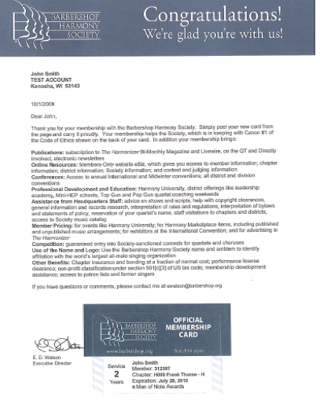
Presenting the Official Membership

Slide 30

ANNUAL DUES FOR
2016
Society: $120.00
Far Western: $ 25.00
Chapter: $ .00 (insert your amount)
Grand Total: $

Slide 31
2016 DUES STRUCTURE
REGULAR [RG] SOCIETY DUES - $120.00
LIFE MEMBER [LF] DUES – 20 X ANNUAL DUES OF A REGULAR [RG] MEMBER
SENIORS [SN] SOCIETY DUES - $60.00
YOUTH [Y2] SOCIETY DUES - $60.00
DUAL MEMBERSHIP SOCIETY DUES - $120.00 (PAID ONLY ONCE NO
MATTER THE NUMBER OF CHAPTERS A MEMBER BELONGS TO)
FRANK H. THORNE CHAPTER DUES - $120.00 + DISTRICT DUES
FAR WESTERN DISTRICT DUES - $25.00
CHAPTER DUES – VARIES

Slide 32

EASYDUES ANNUAL PAYMENT
MEMBER PAYS HIS FULL DUES UPON RECEIPT OF THE INVOICE FROM THE SOCIETY.
EASYDUES NEW MEMBER INSTALLMENT PLAN
PLAN DESIGNED FOR NEW MEMBERS ONLY.
MEMBER PAYS $10 ENROLLMENT FEE UPON JOINING.
NEW MEMBER EITHER PAYS ONE-HALF THE DUES UPON JOINING WITH BALANCE DUES 6-MONTH LATER OR HAS 1/6TH OF HIS DUES PAID MONTHLY WITH AUTODRAFT PAYMENT THROUGH CHECKING ACCOUNT OR CREDIT CARD PAYMENT.
COMPLETES AUTODRAFT PAYMENT FORM AND SUBMITS IT WITH APPLICATION, IF HE CHOOSES TO PAY IN SIX INCREMENTS.
UPON FULL PAYMENT MEMBER RECEIVES NEW MEMBER KIT, MEMBERSHIP CERTIFICATE, LAPEL PIN, AND MEMBERSHIP CARD WITH EXPIRATION DATE 12 MONTHS FROM THE END OF THE 6-MONTH INSTALLMENT MEMBERSHIP.

Slide 33

4 EASYDUES PAYMENT OPTIONS
EASYDUES AUTODRAFT PLAN
MONTHLY PREPAYMENT PLAN COLLECTED VIA VISA/MASTERCARD CREDIT CARD ONLY.
PUT INTO EFFECT FOR THE FOLLOWING YEAR AFTER YOU PAY THE CURRENT YEAR’S INVOICE.
AUTODRAFT APPLICATION IN CS EXHIBITS MANUAL.
BEGINNING IN 2008 NO AUTODRAFT EASTDUES USING SHARE DRAFT FROM CHECKING ACCOUNT FOR NEW MEMBERS.
EASY DUES ESCROW PLAN
SOMETIMES CALLED “PAY AS YOU GO JOE”.
MEMBER PAYS A PORTION OF HIS DUES WEEKLY OR MONTHLY TO THE CHAPTER TREASURER OR HIS DESIGNEE.
CHAPTER TREASURER OR DESIGNEE ISSUES A RECEIPT FOR CASH RECEIVED FROM THE MEMBER.
WHEN RENEWAL NOTICE IS RECEIVED BY THE MEMBER HE SUBMITS THIS NOTICE TO THE
CHAPTER TREASURER WHO ISSUES A CHECK TO COVER THE AMOUNT ON THE NOTICE. THE
MEMBER SENDS THE CHECK TO THE SOCIETY.
MAJOR DISADVANTAGE OF THIS PLAN IS THAT IT REQUIRES A LARGE AMOUNT OF BOOKKEEPING FOR THE CHAPTER TREASURER.

Slide 34
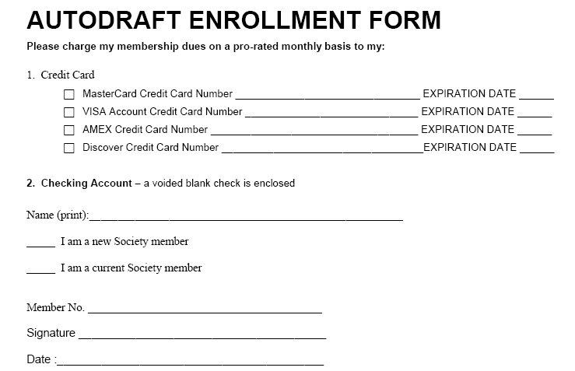


Slide 35

LEADERSHIP LINKAGES
WAYS TO SHOW LEADERSHIP IN YOUR CHAPTER…
TELL MEMBERS ABOUT
THE VARIOUS OPTIONS
FOR PAYING
THEIR DUES OR PROGRAMS THAT WILL
SAVE THEM MONEY ON
THEIR ANNUAL DUES

Slide 36

ANNUAL RENEWALS
U.S. CHAPTERS
6-8 WEEKS BEFORE EXPIRATION DATE THE MEMBER RECEIVES A RENEWAL NOTICE BY E-MAIL OR U.S. MAIL.
MEMBER SENDS HIS ANNUAL DUES TO THE SOCIETY OR MAY RENEW ONLINE USING A MASTERCARD, VISA, AMERICAN EXPRESS, OR DISCOVER CREDIT CARD.
NEW MEMBERSHIP CARD IS SENT TO THE CHAPTER SECRETARY.

Slide 37
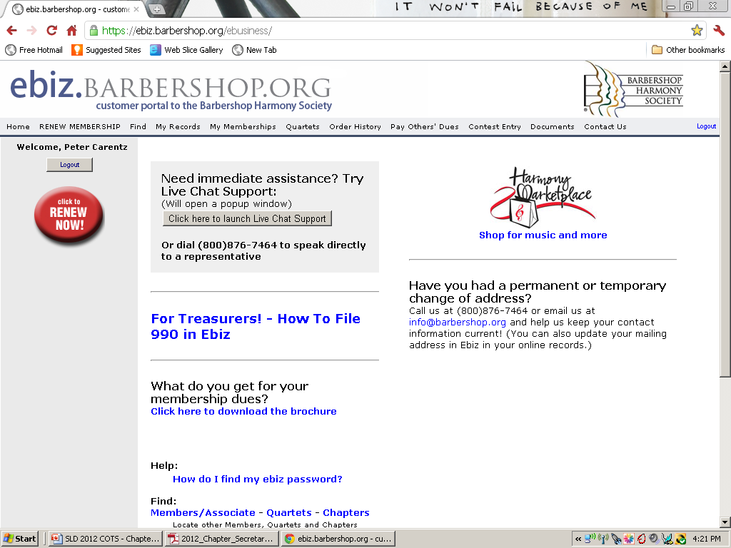

USE EBIZ TO RENEW MEMBERSHIP
GO TO MEMBER’S PAGE ON WWW.EBIZ.BARBERSHOP.ORG
ON THE EBIZ PAGE CLICK ON THE LARGE RED EASY BUTTON
MEMBER MUST PAY WITH A CREDIT CARD
MASTERCARD
VISA
AMERICAN EXPRESS
DISCOVER CARD
POSTING WILL TAKE A FEW DAYS, BUT ONCE PAID YOUR MEMBERSHIP IS RENEWED.
CONSIDER EASYDUES PAYMENT OPTIONS .

Slide 38
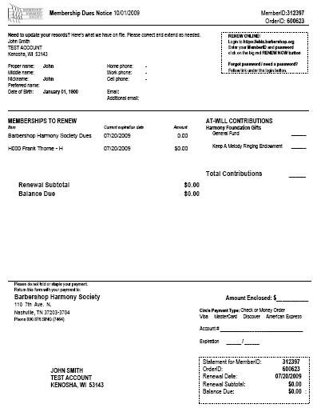
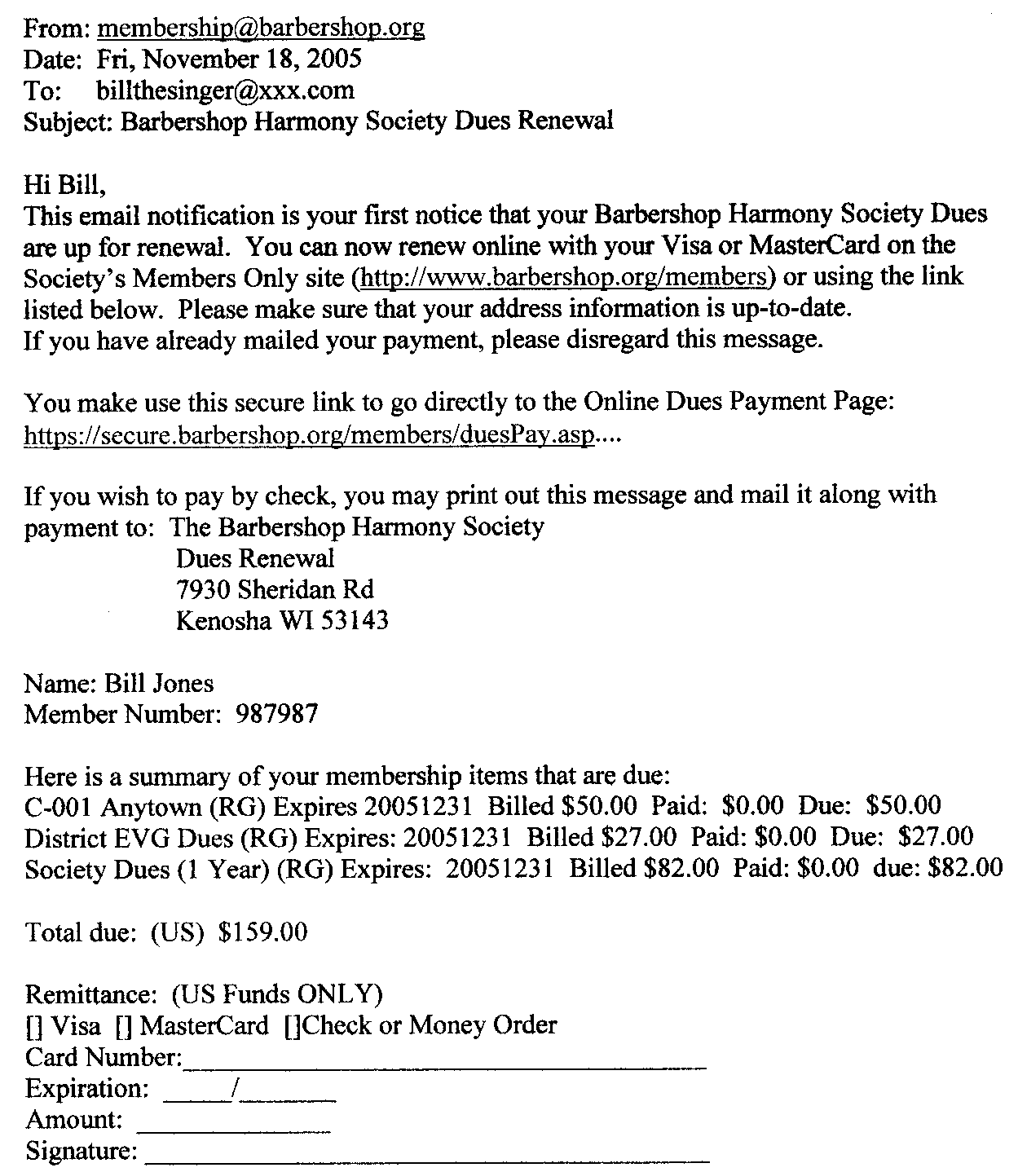

Slide 39
LAPSED MEMBERSHIPS
LATE RENEWAL
MEMBER DUES THAT ARE LESS THAN
6-MONTHS LATE
MEMBER PAYS DUES AND ADDS A $3.00 LATE CHARGE FEE TO AMOUNT OWED.
RENEWED MEMBERSHIP CARD IS SENT TO CHAPTER SECRETARY.
THERE IS NO NEW EXPIRATION DATE… SO, MEMBER NEEDS TO BE REMINDED THAT IT MAY APPEAR TO HIM HE GETS FEWER MONTHS
BEFORE NEXT RENEWAL.
REINSTATED MEMBERSHIP
MEMBER DUES THAT ARE MORE THAN
6-MONTHS LATE
MEMBER COMPLETES A NEW APPLICATION FOR MEMBERSHIP AND
SUBMITS FEES WITH APPLICATION.
NEW MEMBER KIT, MEMBERSHIP
CERTIFICATE, LAPEL PIN, AND
MEMBERSHIP CARD IS SENT TO
CHAPTER SECRETARY.
MEMBER WILL HAVE A NEW
MEMBERSHIP EXPIRATION DATE.

Slide 40

LEADERSHIP LINKAGES
WAYS TO SHOW LEADERSHIP
IN YOUR CHAPTER…
FOLLOW-UP ON MEMBERS
WHO ARE ABSENT FROM YOUR CHAPTER MEETING. SOMETHING AS SIMPLE AS “WE MISSED YOU, IS EVERYTHING OKAY?” GOES QUITE A LONG WAY FOR A MAN’S SENSE OF BELONGING.

Slide 41
CHAPTER ROSTER
PUBLISHING A CHAPTER ROSTER REGULARLY IS A DUTY OF THE CHAPTER SECRETARY
PUBLISH A ROSTER QUARTERLY AFTER RENEWALS HAVE BEEN PROCESSED.
GENERATE A CHAPTER MEMBERSHIP LIST FROM SOCIETY'S “MEMBERS
ONLY” PAGE.
ASK MEMBERS TO REVIEW THEIR INFORMATION AND UPDATE, IF
NECESSARY.
SOCIETY WEB PAGE LINK TO “MEMBERS ONLY” CAN GENERATE A
FINAL ROSTER FOR YOU, OR YOU CAN USE THE INFORMATION TO
CONSTRUCT YOUR OWN ROSTER IN WORD OR EXCEL.
DISTRIBUTE TO THE MEMBERSHIP.

Slide 42
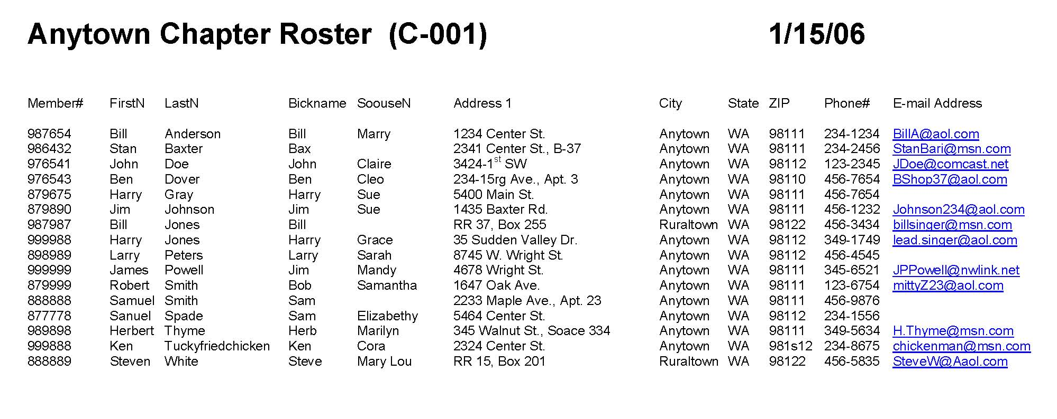

Slide 43
PERSONNEL CHANGES
UPDATING CHAPTER OFFICER CHANGES
NOTIFY THE SOCIETY AND DISTRICT SECRETARY OF OFFICER CHANGES
IT IS NOT NECESSARY TO NOTIFY SOCIETY OR DISTRICT SECRETARY OF CHANGES FOR THE GENERAL MEMBERSHIP.
NOTIFICATION IS INTENDED FOR CHAPTER OFFICER PERSONNEL CHANGES OR CHANGES IN OFFICER’S INFORMATION PROFILE.
COMPLETE AND SUBMIT A REPORT CHANGE FORM OR NOTIFY SOCIETY AND DISTRICT SECRETARY BY E-MAIL.
NOTIFY THE SOCIETY IMMEDIATELY IN THE CASE OF A MEMBER WHO PASSES AWAY.

Slide 44
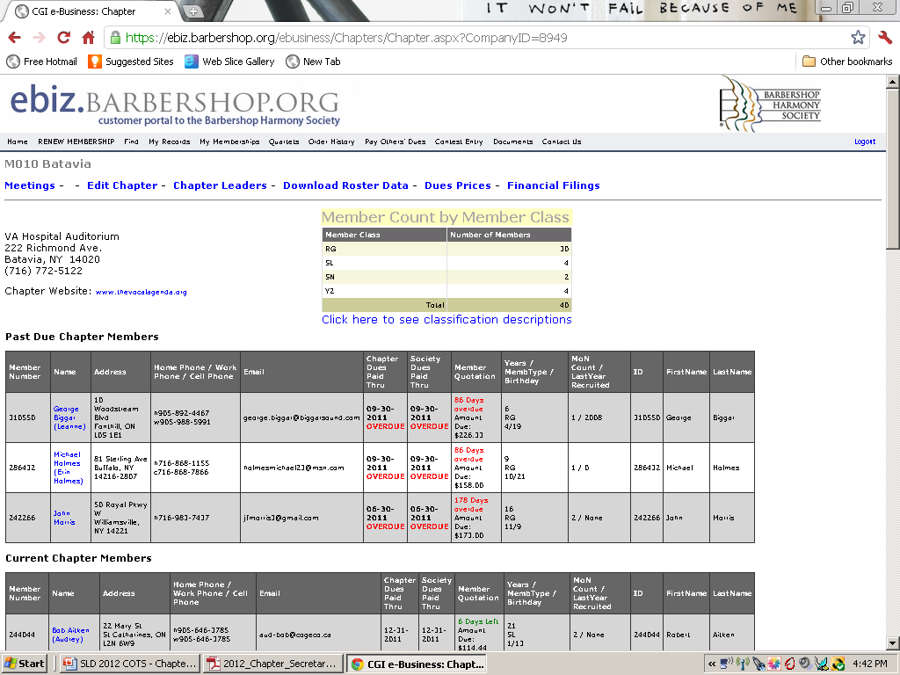
ebiz CAN ASSIST YOU!
HELPS KEEP CHAPTER MEMBERSHIP RECORDS ORGANIZED
READILY SHOWS WHICH MEMBERS HAVE LAPSED MEMBERSHIP
IT WILL HELP YOU WITH ROSTERS
GIVES AN ACCURATE COUNT OF MEMBERSHIP IN THE VARIOUS MEMBERSHIP CLASSIFICATIONS
EASY TO READ AND INTERPRET
CAN ASSIST YOU TO DETERMINE WHICH MEMBERS ARE ELIGIBLE TO COMPETE
PROVIDES CAPABILITIES TO FIND INFORMATION ABOUT MEMBERS WHO:
- HAVE DROPPED OUT OF THE HOBBY
- LIVE WITHIN YOUR AREA, BUT ARE NOT AFFILIATED WITH A CHAPTER
- NEED CURRENT INFORMATION TO UPDATE THEIR MEMBERSHIP PROFILE

Slide 45
SOCIETY YOUTH POLICY
IT IS THE POLICY OF THE SOCIETY THAT ALL YOUTH UNDER 18-YEARS OLD MUST HAVE THE PERMISSION OF THEIR PARENT OR GUARDIAN TO PARTICIPATE IN ALL CHAPTER ACTIVITIES AND THAT AN ADULT MEMBER MUST SUPERVISE THE YOUTH AT ALL TIMES AT THE ACTIVITIES
A PARENT OR GUARDIAN MUST COMPLETE AND SIGN A YOUTH POLICY
MEMBERSHIP FORM.
A PARENT OR GUARDIAN MUST COMPLETE AND SIGN A YOUTH POLICY
PARTICIPATION FORM FOR EACH ACTIVITY.
THE CHAPTER SECRETARY MUST FILE ALL FORMS IN CHAPTER LEGAL FILE.
EACH YOUTH MEMBER MUST BE SUPERVISED BY AN ADULT MEMBER AT
ALL CHAPTER-, DISTRICT- OR SOCIETY-SPONSORED ACTIVITIES AT ALL TIMES.

Slide 46
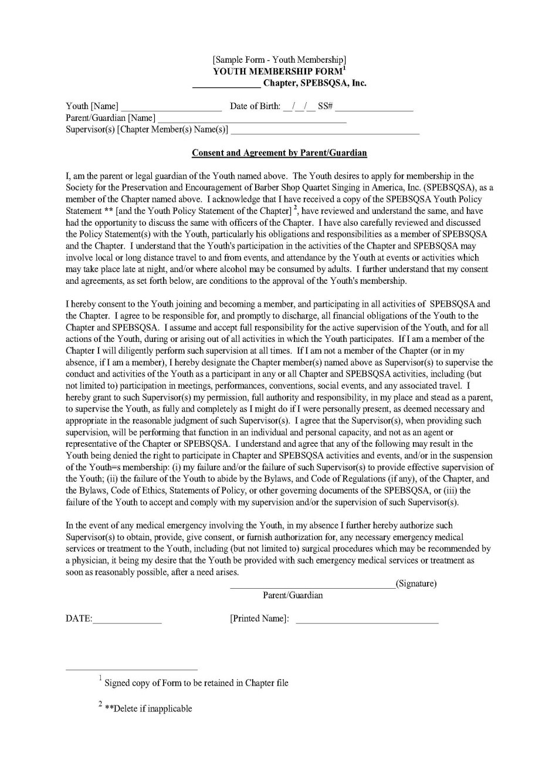
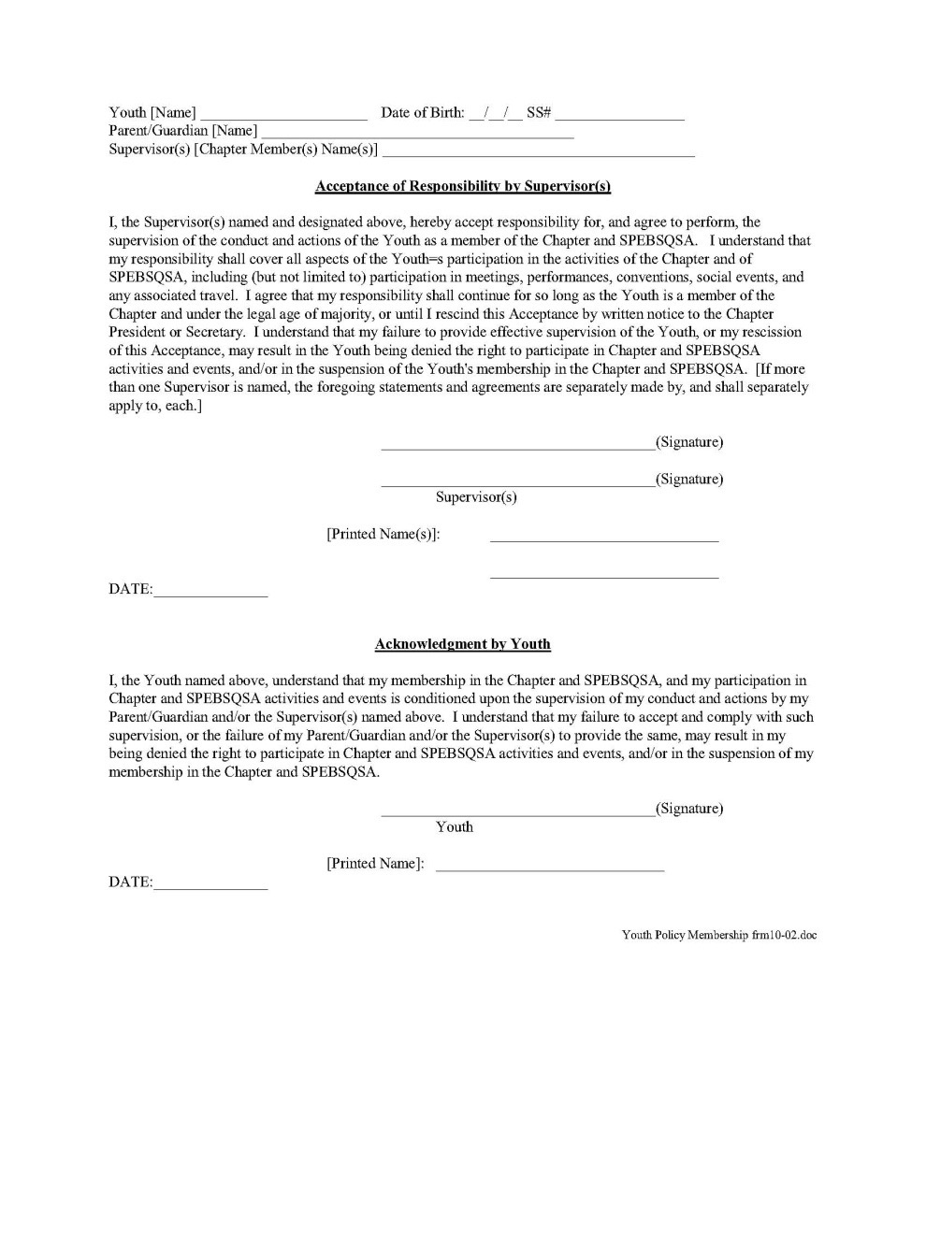

Youth Membership Form

Slide 47
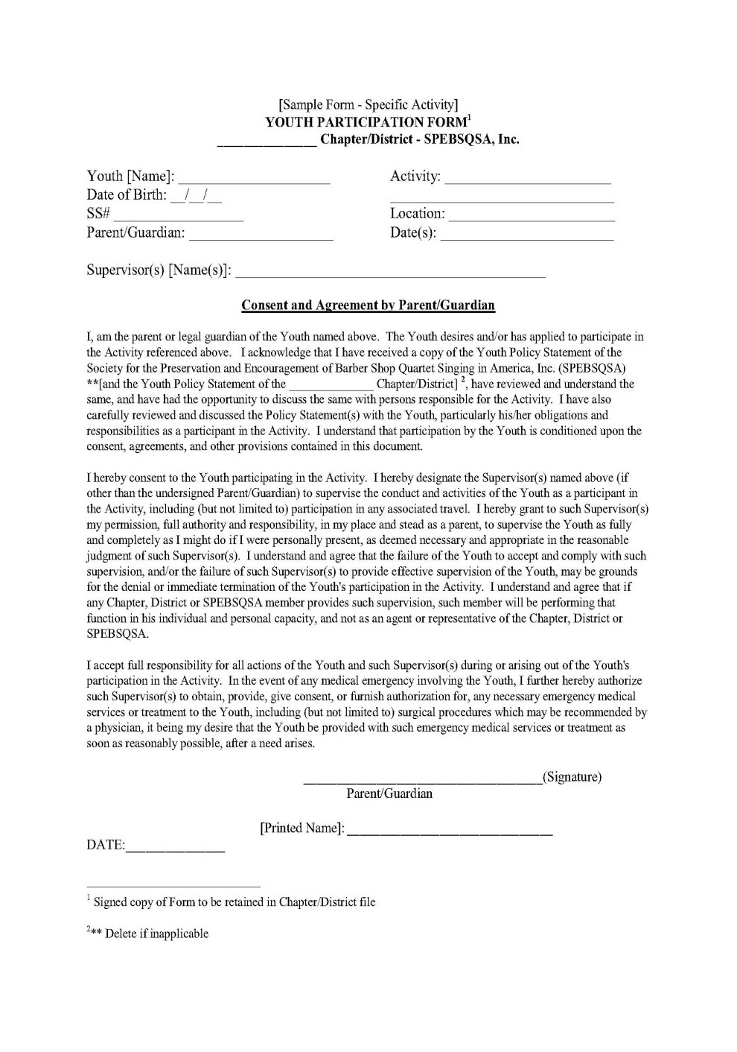
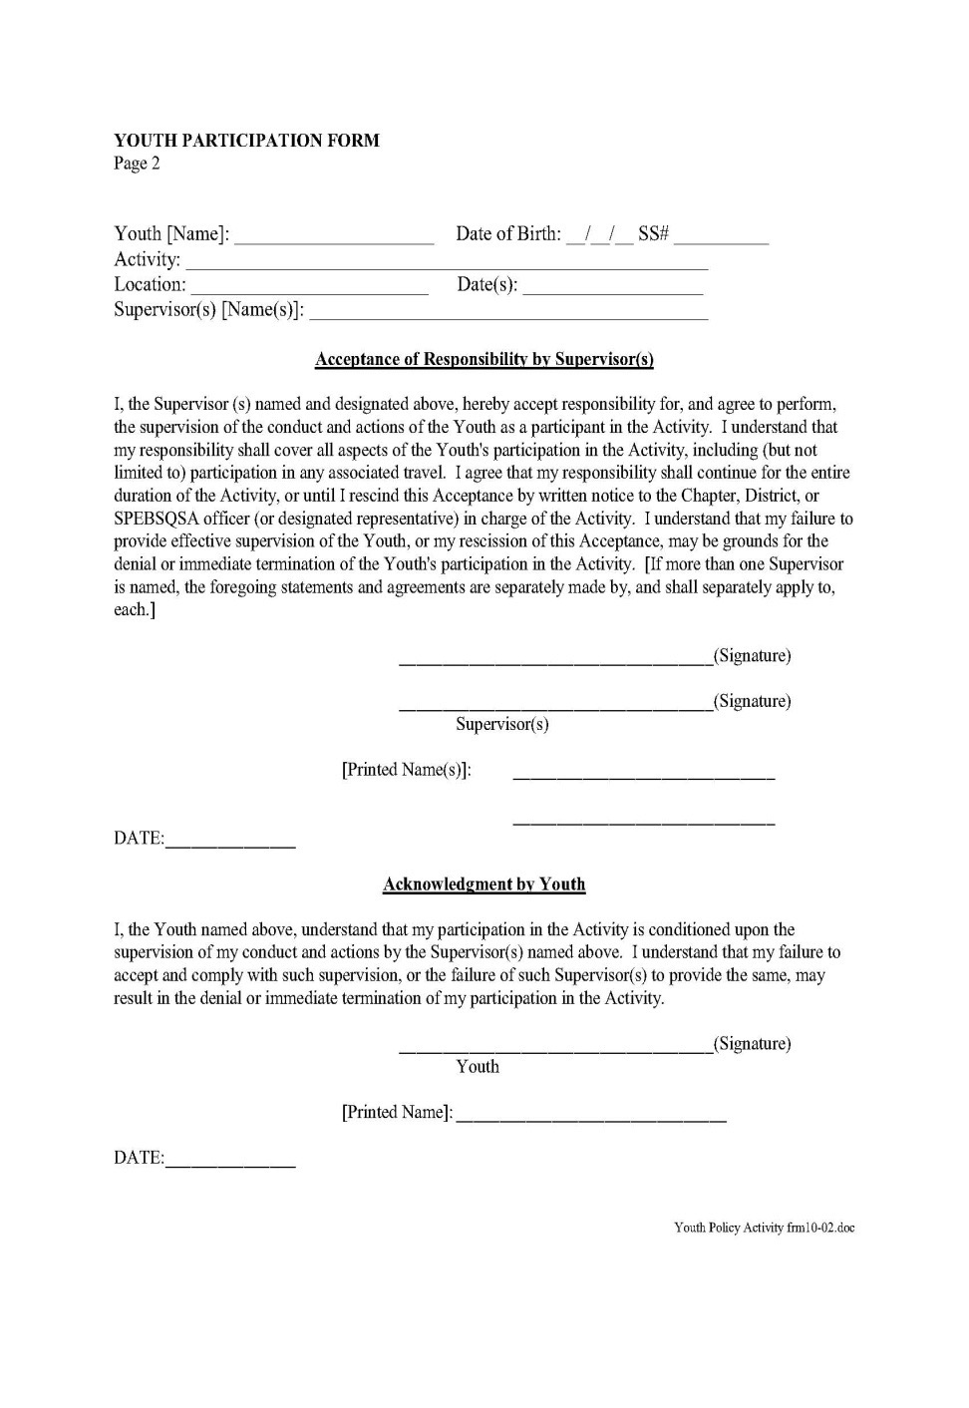
Youth Participation Form

Slide 48
SECRETARY’S CLASS- SESSION 2

Slide 49

CHAPTER LIABILITY INSURANCE
EACH CHAPTER AUTOMATICALLY CARRIES GENERAL LIABILITY INSURANCE (BODILY INJURY, AND PROPERTY DAMAGE).
PROTECTS THE CHAPTER, DISTRICT AND SOCIETY FROM THIRD-PARTY LIABILITY CLAIMS.
DOES NOT COVER CHAPTER MEMBERS.
LIMIT OF THE POLICY IS $10 MILLION FOR EACH OCCURRENCE.
THE ANNUAL FEE FOR THE LIABILITY INSURANCE IS INVOICED ON THE DECEMBER SOCIETY STATEMENT TO THE CHAPTER.
CHAPTERS MAY NOT OPT OUT OF THIS INSURANCE POLICY.

Slide 50
BONDING INSURANCE
EACH CHAPTER IS AUTOMATICALLY COVERED BY BONDING INSURANCE.
THOSE COVERED BY BONDING INSURANCE MUST BE WRITTEN INTO THE MINUTES AT THE JANUARY MEETING OF THE CHAPTER BOARD OR AT SUBSEQUENT MEETINGS WHEN ANOTHER INDIVIDUAL BECOMES KNOWN WHO HANDLES MONEY.
CHAPTER IS COVERED TO $50,000 FOR LOSSES BY AN INDIVIDUAL MISAPPROPRIATING FUNDS.
CHAPTER MAY NOT OPT OUT OF THIS COVERAGE AND FEE IS PAID IN DECEMBER
THERE IS $1000 DEDUCTIBLE ON EACH CLAIM.

Slide 51
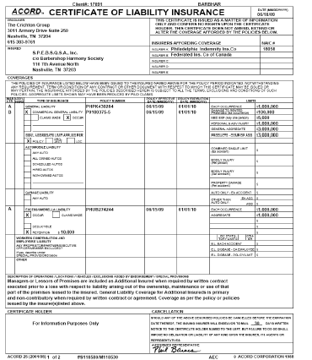
CERTIFICATE OF LIABILITY INSURANCE
REQUIRED FOR MOST FACILITY RENTALS
CONTACT AGENT TO RECEIVE ONE CERTIFICATE SPECIFIC FOR YOUR EVENT
OUTLINES PROOF OF COVERAGE
CERTIFICATE WILL CHANGE ON JANUARY 1, 2016
CHECK DOCUMENT CENTER FOR NEW CERTIFICATE – GENERIC COPY DOWNLOADABLE – AFTER 1/1/2016.

Slide 52
OPTIONAL INSURANCE
CHAPTER PROPERTY INSURANCE
RECOMMENDED FOR CHAPTERS WITH RISERS, SOUND EQUIPMENT AND UNIFORMS.
RECOMMENDED FOR CHAPTERS WITH VEHICLES OR TRAILERS TO TRANSPORT RISERS, UNIFORMS AND OTHER CHAPTER PROPERTY.
CONTACT SOCIETY INSURANCE AGENT OR A LOCAL AGENT.
BROCHURES FOR VARIOUS PLANS
ARE AVAILABLE ONLINE AT
WWW.BARBERSHOP.ORG
DOCUMENT CENTER

Slide 53
OPTIONAL INSURANCE
LIABILITY INSURANCE FOR MEMBERS
AVAILABLE TO COVER MEMBERS AS SEPARATE COVERAGE.
CONTACT SOCIETY INSURANCE AGENT OR A LOCAL AGENT.
BROCHURES FOR VARIOUS PLANS
ARE AVAILABLE ONLINE AT
WWW.BARBERSHOP.ORG
DOCUMENT CENTER

Slide 54
INSURANCE CLAIMS PROCESS
CONTACT DIRECTOR OF FINANCE ADMINISTRATION AT THE SOCIETY.
SHARE THE FOLLOWING INFORMATION:
- NAME, ADDRESS AND PHONE NUMBER OF THE INDIVIDUAL(S) INVOLVED
- DATE AND LOCATION OF THE INCIDENT
- PERTINENT DETAILS OF THE ACCIDENT OR INCIDENT
IMPORTANT
DO NOT MAKE ANY STATEMENTS (WRITTEN OR OTHERWISE) TO ANYONE EXCEPT THE BARBERSHOP HARMONY SOCIETY’S INSURANCE AGENT OR INVESTIGATING POLICE OFFICIALS.
THE SOCIETY AND ITS INSURANCE AGENT WILL DO ANY FOLLOW-UP.

Slide 55

ASCAP/BMI/SESAC
BMI/SESAC CLEARANCE
SHOW CLEARANCE FORM USED BY U.S.
CHAPTERS AND SUBMITTED TO THE
DISTRICT SECRETARY
ASCAP LICENSING
SUBMITTED TO DISTRICT SECRETARY AND POSTED ONLINE AT SOCIETY EBIZ WEB SITE

Slide 56


BMI/SESAC SHOW CLEARANCE PROCESS
COMPLETE BMI/SESAC FORM AND FEES FROM TABLE ON THE FORM.
SEND THE COMPLETED FORM AND PAYMENT FOR EACH SHOW TO YOUR DISTRICT SECRETARY.
DISTRICT SECRETARY CONFIRMS APPROVAL OF SHOW BY EMAIL BACK TO THE CHAPTER
CLEARING THE SHOW DATE AND PLACES THE SHOW DATE ON THE DISTRICT CALENDAR.
THE CHAPTER IS FREE TO FINALIZE VENUE AND TALENT CONTRACTS.
SIGNED FORM IS STORED BY CHAPTER SECRETARY IN CHAPTER LEGAL FILE.

Slide 57
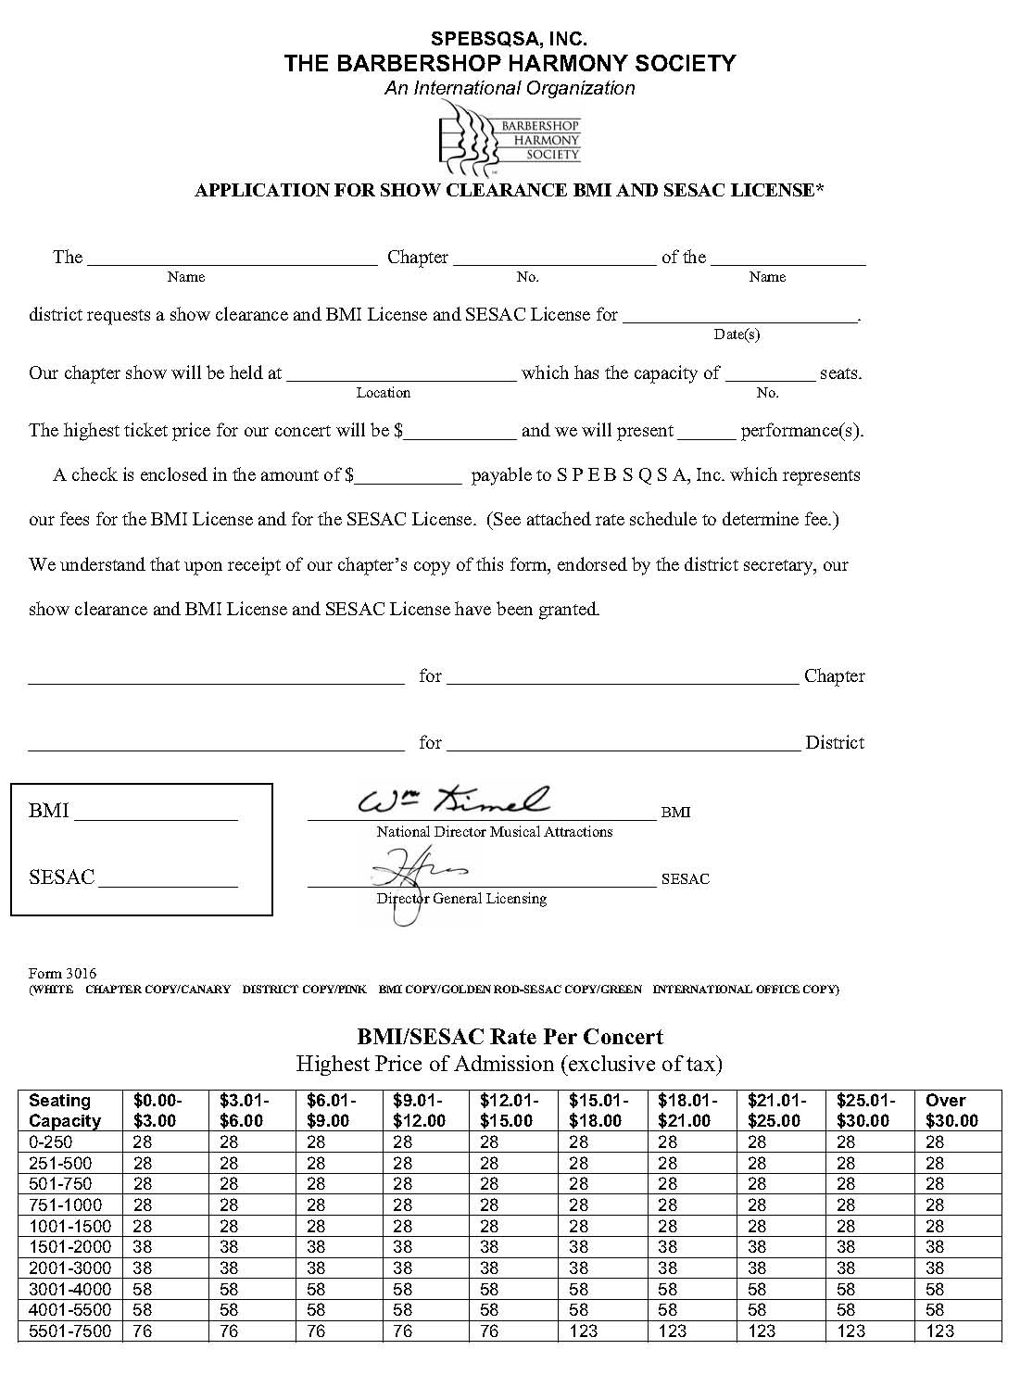
Application
for Show
Clearance
BMI & SESAC
License

Slide 58
ASCAP LICENSING PROCESS
ANY CHAPTER WHO HAS A SHOW WILL ANNUALLY PAY $241.00. IF THE FEES FOR THE YEAR EXCEED THAT AMOUNT YOU WILL BE BILLED BY ASCAP. IF YOUR FEES FOR THE YEAR DO NOT RISE TO THE AMOUNT, YOU WILL HAVE TO PAY THE MINIMUM $241.00 FEE.
THERE ARE SPECIAL RATES FOR BENEFIT SHOWS.
THERE ARE SPECIAL ADDITIONAL FEES FOR SCRIPTED SHOWS OR SHOWS
DEDICATED TO A SPECIFIC COMPOSER.
KEEP A COPY OF ALL COMPLETED FORMS IN THE CHAPTER LEGAL FILE.

Slide 59
CHAPTER INCORPORATION
IT IS THE POLICY OF THE SOCIETY THAT EACH CHAPTER IS
INCORPORATED IN THE STATE OR PROVINCE WHERE THEY RESIDE
INCORPORATION PROTECTS INDIVIDUAL MEMBERS FROM LAWSUITS
BROUGHT AGAINST THE CHAPTER
CONTACT THE SECRETARY OF YOUR STATE OR PROVINCE TO DETERMINE IF YOUR CHAPTER IS INCORPORATED. OFTEN THIS CAN BE DONE ONLINE.
INCORPORATION MUST BE CONFIRMED ANNUALLY (USUALLY IN APRIL) BY RECEIVING A CERTIFICATE OF CONTINUED EXISTENCE AND THE PAYMENT OF AN ANNUAL FEE TO THE STATE OR PROVINCE.
REVIEW WITH THE CHAPTER TREASURER TO DETERMINE IF THE ANNUAL FEE HAS BEEN PAID.
EACH CHAPTER NEEDS A RESIDENT AGENT TO MONITOR THE CONTINUED ANNUAL INCORPORATION OF THE CHAPTER.

Slide 60
COPYRIGHT LAW
IT IS AGAINST THE LAW TO…
REPRODUCE THE COPYRIGHTED WORKS IN COPIES AND RECORDINGS;
PREPARE DERIVATIVE WORKS BASED ON THE COPYRIGHTED WORK;
PERFORM THE COPYRIGHTED WORK PUBLICLY;
DISTRIBUTE THE COPYRIGHTED WORK PUBLICLY; AND
DISPLAY THE COPYRIGHTED WORK PUBLICLY.
IT IS YOUR DUTY TO REMIND YOUR CHAPTER
OFFICERS OF THESE COPYRIGHT RESTRICTIONS

Slide 61

COPYRIGHT INFRINGEMENT
$50,000 PER COPY
OF PRINTED OR RECORDED MATERIAL
IF YOU HAVE QUESTIONS REGARDING
COPYRIGHT LAW, PROCESS FOR
MAKING AUDIO TAPES, VIDEO TAPES,
DVDS, PRINTED SHEET MUSIC
CONTACT BARBERSHOP HARMONY SOCIETY
(JOE LILES) AT 1-800-SING (7464).

Slide 62
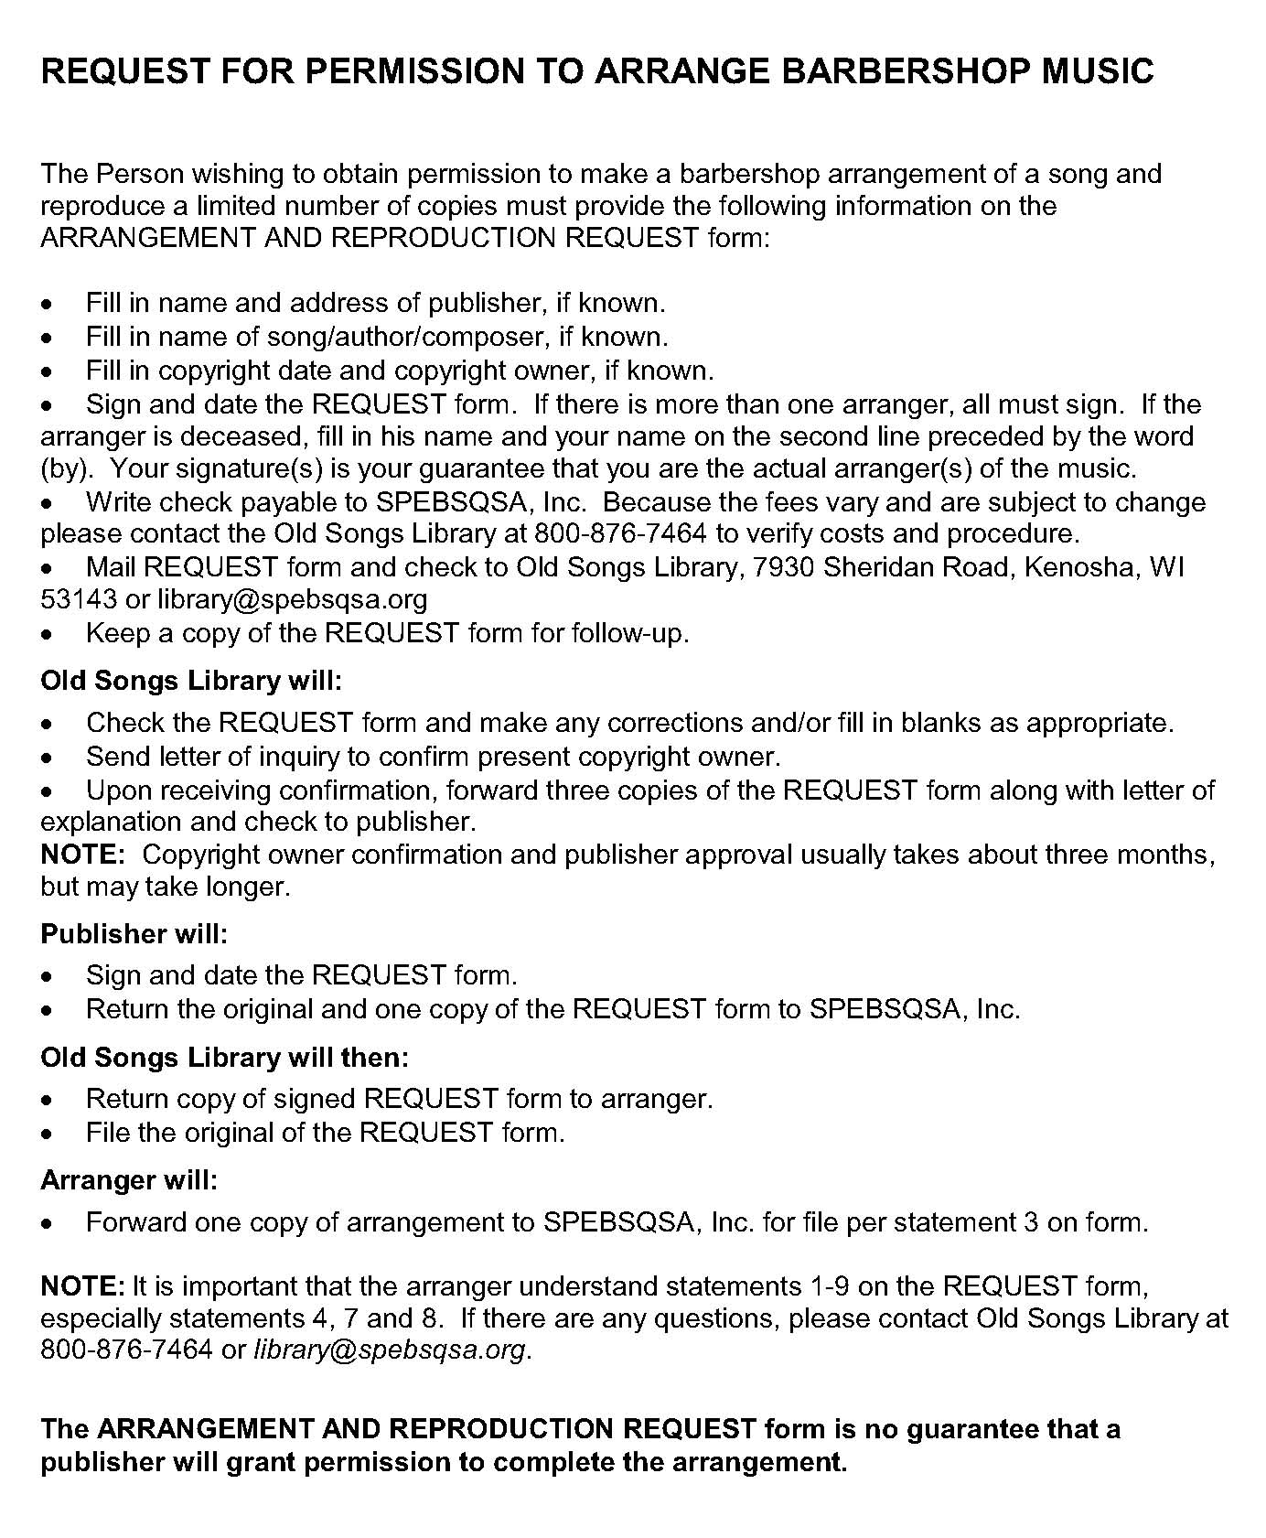
Request for Permission
to Arrange

Slide 63
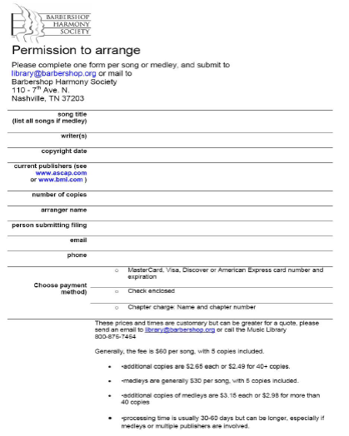
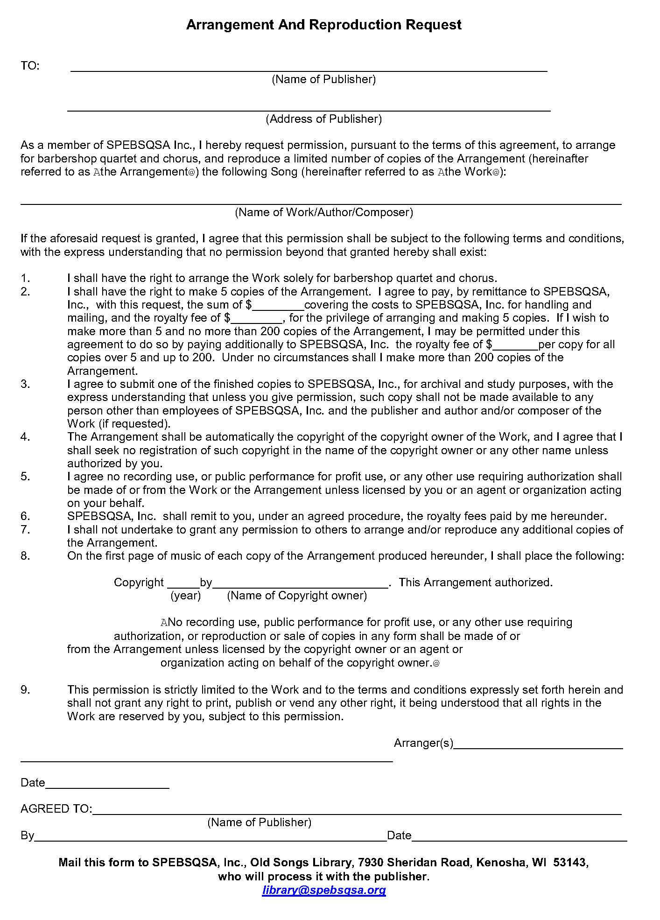
Request for Permission
to Arrange Form

Slide 64


CHAPTER LEGAL FILES
Store all chapter legal documents together in a file box or cabinet at
a safe location
The chapter secretary is responsible for maintaining the chapter
legal file
INCORPORATION RECORDS
CERTIFICATE OF CONTINUED EXISTENCE
RESIDENT AGENT CERTIFICATE
CHAPTER CHARTER
CHAPTER BYLAWS
CHAPTER RULES AND REGULATIONS
CHAPTER MEMBERSHIP REPORTS
MEMBERSHIP APPLICATIONS
CHAPTER STATEMENT OF POLICY
COPY OF TRANSACTIONS AND MEETING MINUTES
INSURANCE AND BONDING RECORDS
YEAR-END TREASURER REPORT AND IRS 990 FORMS
ANNUAL FINANCIAL REPORTS
DIRECTOR CONTRACTS
SHOW TALENT CONTRACTS

Slide 65

HOW LONG DO WE KEEP OUR
CHAPTER RECORDS?
IN GENERAL, KEEP DOCUMENTS AND RECORDS FOR YOUR CHAPTER FOREVER
REVIEW TABLE 3 (SECTION 4.8.6) IN THE 2013 CHAPTER SECRETARY MANUAL
DISCUSS WITH YOUR CHAPTER BOARD OF DIRECTORS THE BEST WAY TO STORE YOUR CHAPTER RECORDS
EXPLORE SAVING YOUR DOCUMENTS ELECTRONICALLY AND STORE IN A SAFE LOCATION

Slide 66

PREPARING FOR A NATURAL DISASTER
AS CHAPTER SECRETARY YOU ARE
RESPONSIBLE FOR THE SAFEKEEPING OF
ALL CHAPTER RECORDS AND FILES
PLAN AHEAD FOR A DISASTER.
CONSIDER SCANNING YOUR DOCUMENTS AND STORING THEM ON A CD ROM.
STORE YOUR CHAPTER DOCUMENTS IN A LOCATION SAFE FROM THE ELEMENTS.
KEEP CHAPTER RECORDS AND LEGAL FILE ACCORDING TO THE TABLE IN THE 2012 CHAPTER SECRETARY MANUAL (4.8.6, TABLE 3)

Slide 67

LEADERSHIP LINKAGES
WAYS TO SHOW
LEADERSHIP IN YOUR
CHAPTER
BE THE CONSCIENCE FOR
YOUR CHAPTER AND BE
CONCERNED THEY STAY
LEGAL BY MAINTAINING AN
ORGANIZED AND UP-TO-
DATE LEGAL FILE

Slide 68

IS YOUR CHAPTER PREPARED FOR A VISIT FROM THE IRS?
ALL LEGAL DOCUMENTS FOR YOUR CHAPTER IN ORDER
FINANCIAL REPORTS AND RECORDS AND MINUTES IN ORDER
VERY IMPORTANT
A RUNNING FORMAL LIST OF SERVICE AND COMMUNITY ACTIVITIES YOUR CHAPTER HAS PARTICIPATED IN

Slide 69
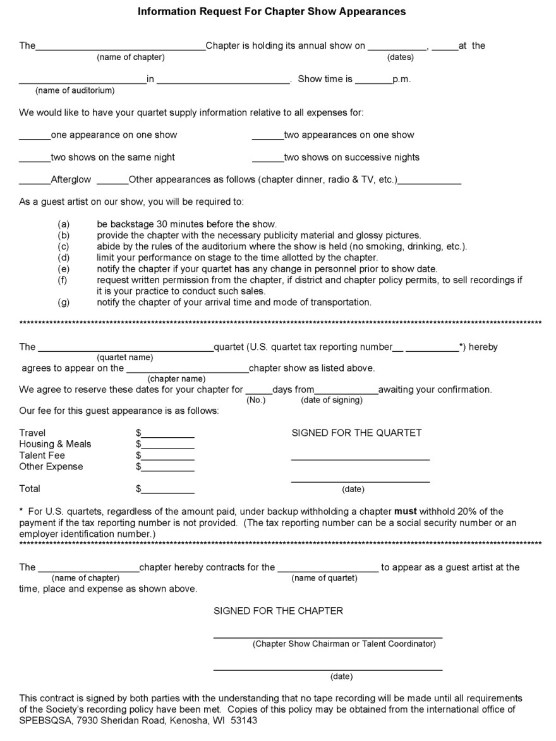
SHOW TALENT CONTRACTS
IMPORTANT
NEVER SIGN ANY CONTRACTS WITH
TALENT OR VENUE UNTIL THE SHOW DATE IS CLEARED BY DISTRICT SECRETARY.
GET EVERYTHING IN WRITING!
UTILIZE TALENT CONTRACT TO FINALIZE AND CLARIFY DETAILS.
STIPULATE A DEADLINE TO RETURN SIGNED CONTRACT
IN U.S., REMIND CHAPTER TREASURER OF IRS 1099 FORM RESPONSIBILITIES FOR REPORTING FEES PAID TO TALENT IN EXCESS OF $600.
FILE CONTRACTS IN CHAPTER LEGAL FILE.

Slide 70
CHAPTER ELECTIONS
CHAPTER ELECTIONS MUST BE HELD BY OCTOBER 15.
CHAPTER ELECTIONS ARE HELD TO COINCIDE WITH THE ANNUAL MEMBERSHIP MEETING, WHICH IS A REQUIREMENT FOR CONTINUED EXISTENCE AS A NOT-FOR PROFIT INCORPORATED ORGANIZATION.
CANDIDATES MUST BE ANNOUNCED TWICE IN THE TWO-WEEKS PRIOR TO THE ANNUAL MEMBERSHIP MEETING.
THE ANNOUNCEMENT OF CANDIDATES AND ANNUAL MEMBERSHIP MEETING SHALL BE DONE BY WRITTEN NOTICE THROUGH E-MAIL, LETTERS TO THOSE WITHOUT E-MAIL OR CHAPTER BULLETIN, AND VERBALLY AT CHAPTER MEETING/REHEARSAL.
ELECTIONS ARE TO BE CONDUCTED WITH SECRET BALLOT, UNLESS THE SLATE OF OFFICERS IS UNCONTESTED.
THE CHAPTER SECRETARY MUST REPORT THE NEW OFFICERS ONLINE NO LATER THAN DECEMBER 1ST.
  FAILURE TO REPORT NEW OFFICERS IS GROUNDS FOR SUSPENSION OF THE CHAPTER CHARTER.

Slide 71
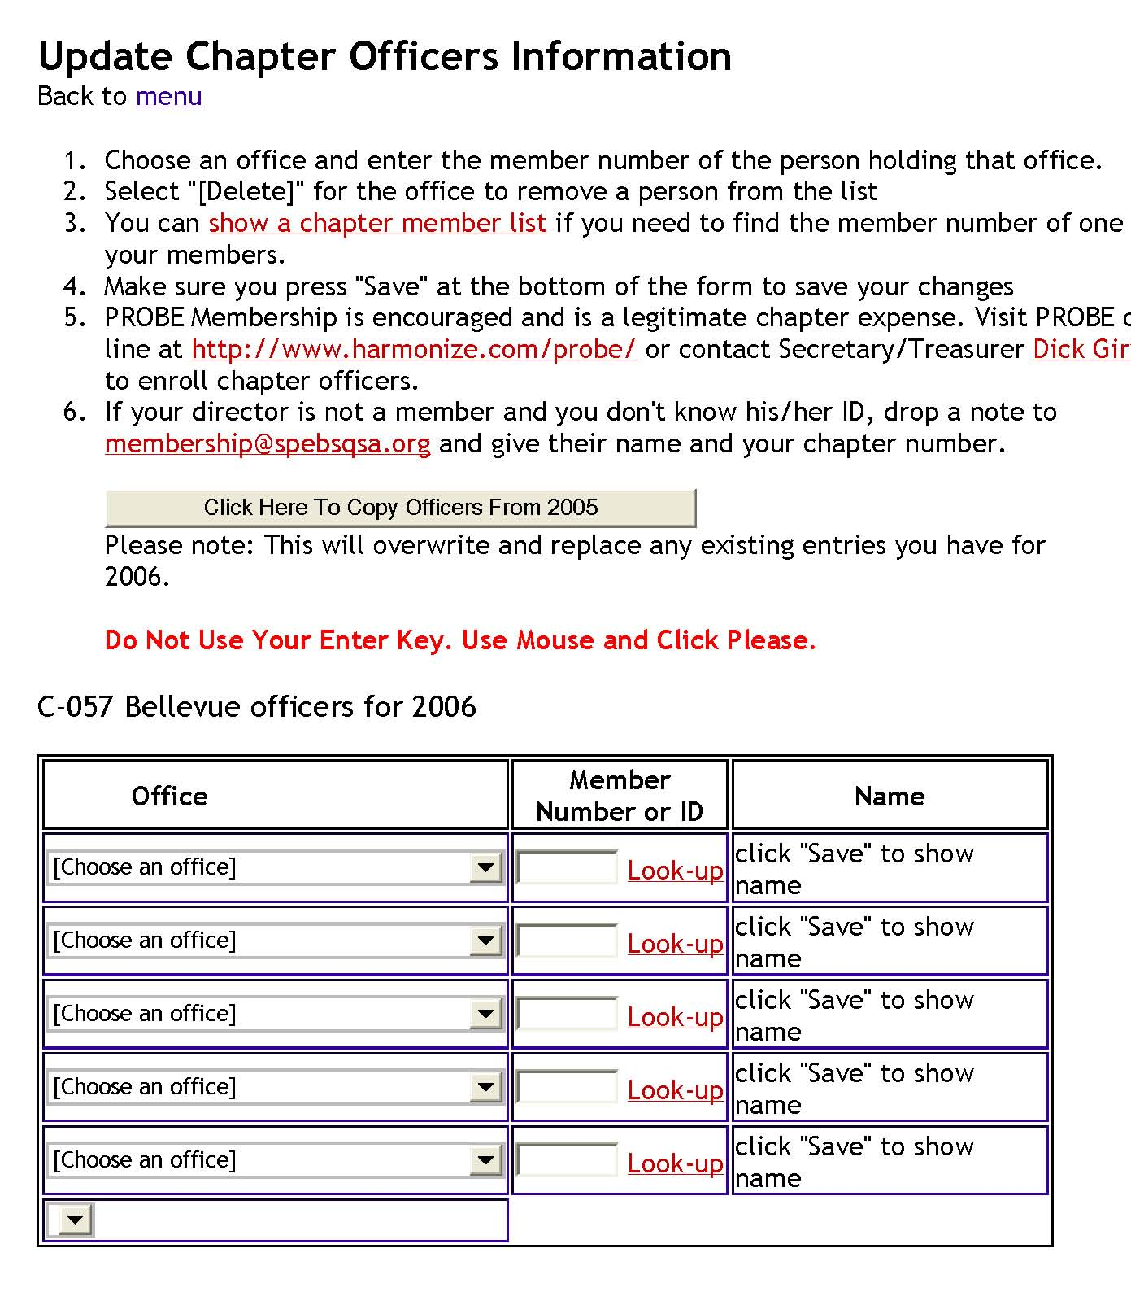
NEW LEADERSHIP REPORTING
NOW REPORTED ONLINE AT
WWW.EBIZ.BARBERSHOP.ORG
MEMBERS LINK.
REPORTING IS TO BE COMPLETED
BY DECEMBER 1ST.
THE BASIC LEADERS FOR MOST
CHAPTERS ARE:
PRESIDENT
VP CHAPTER DEVELOPMENT
VP MUSIC & PERFORMANCE
VP MKTG./PR (25+ MEMBERS)
SECRETARY
TREASURER
ADDITIONAL OFFICERS/LEADERS ARE AT THE DISCRETION OF THE
CHAPTER

Slide 72
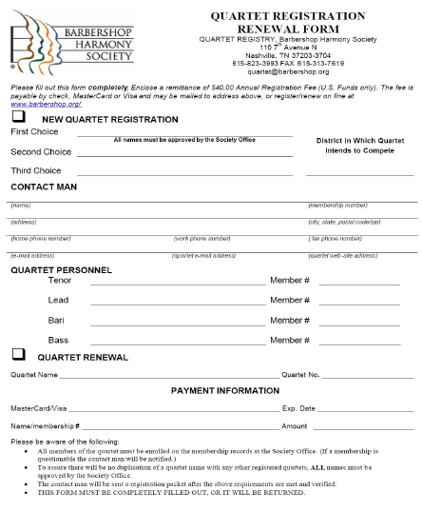
QUARTET REGISTRATION
NOT A CHAPTER SECRETARY DUTY TO REGISTER QUARTETS, HOWEVER, CHAPTER SECRETARY CAN DISTRIBUTE REGISTRATION
FORMS AND ANSWER QUESTIONS
QUARTET COMPLETES HARDCOPY FORM OR ONLINE AT WWW.EBIZ.BARBERSHOP.ORG
THERE IS AN ANNUAL FEE OF $40 TO
INITIALLY REGISTER OR MAINTAIN REGISTRATION OF YOUR QUARTET.
QUARTETS MUST HAVE A NAME THAT IS NOT THE SAME OF PAST SOCIETY INTERNATIONAL QUARTET CHAMPIONS OR CURRENTLY USED BY A REGISTERED QUARTET.
REGISTERED QUARTETS RECEIVE A CARD AND REGISTRATION NUMBER.

Slide 73
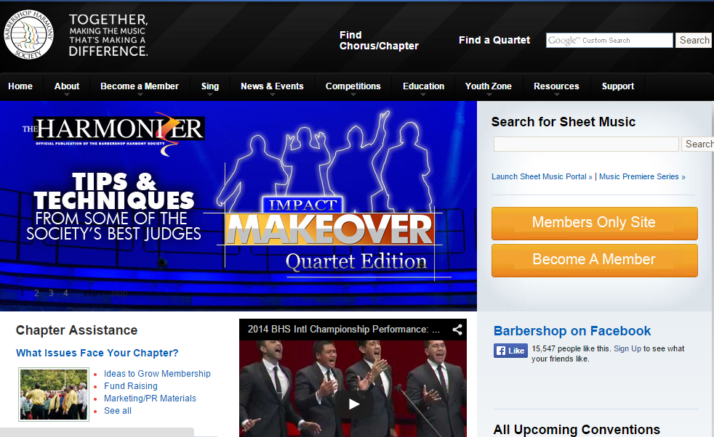
SOCIETY WEB SITE – HOME PAGE

Slide 74
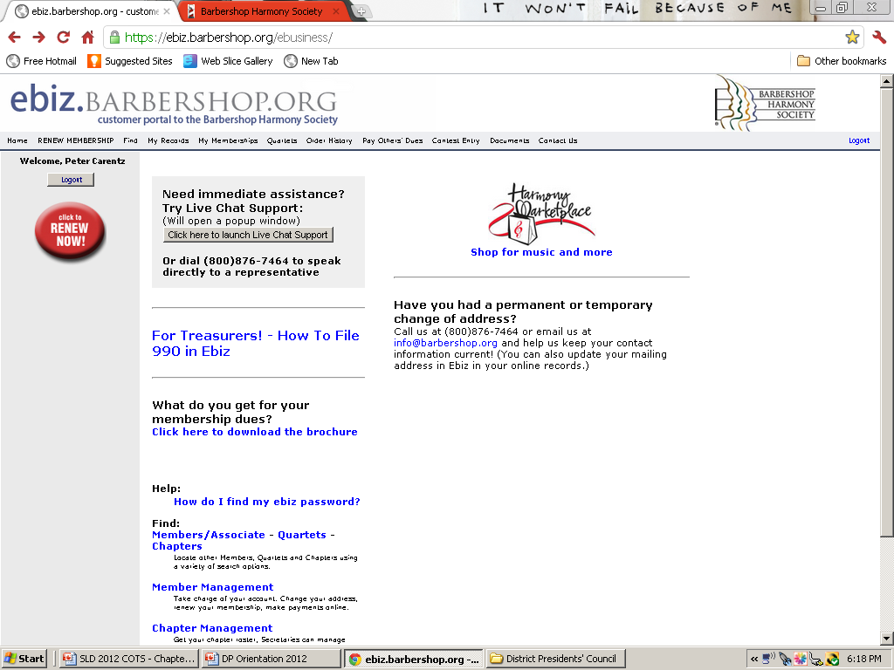
SOCIETY WEB SITE – EBIZ PAGE

Slide 75
EBIZ PAGE –
PROVIDES READY ACCESS TO MEMBER TO UPDATE HIS INFORMATION AND SERVICES LIKE:
PAY FEES OR DUES OR ORDER THINGS FROM THE HARMONY MARKETPLACE.
PROVIDES SERVICES TO THE CHAPTER SECRETARY AND CHAPTER PRESIDENT.
SECURE!
EASY TO NAVIGATE EVEN FOR A COMPUTER CHALLENGED.

Slide 76
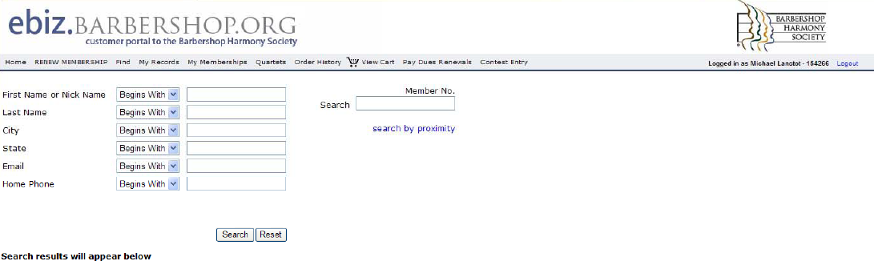
EBIZ PAGE – FIND MEMBERS
TIPS
FILL IN AS MUCH KNOWN INFORMATION AS POSSIBLE.
PARTIAL “KEY WORDS” ARE OKAY , IF YOU ARE NOT SURE OF EXACT SPELLING.
NAMES O’ (I.E. O’REILLY) ENTER LAST NAME AS “O” AND REMAINDER OF LAST NAME
MORE INFORMATION INCLUDED NARROWS THE SEARCH.

Slide 77
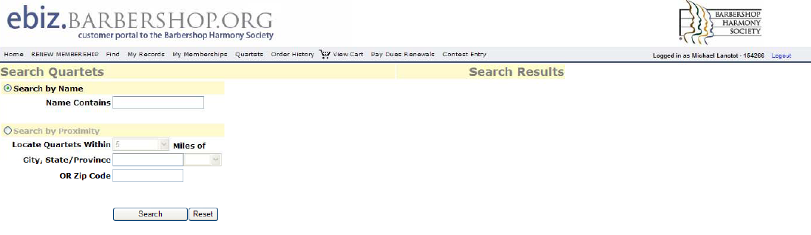
EBIZ PAGE – FIND QUARTETS
TIPS
ENTER NAME OF THE QUARTET EXACTLY THE WAY IT IS SPELLED.
PARTIAL “KEY WORDS” IS OKAY , IF YOU ARE UNSURE OF EXACT SPELLING.
BE CAREFUL. SOME QUARTETS DELIBERATELY MISSPELL THEIR NAMES.
ACTIVE (PAID-UP ANNUAL REGISTRATION) REGISTERED QUARTETS LISTED ONLY.
MAY LOCATE MULTIPLE QUARTETS WITHIN A SPECIFIC GEOGRAPHIC LOCATION (CITY/POSTAL CODE).

Slide 78
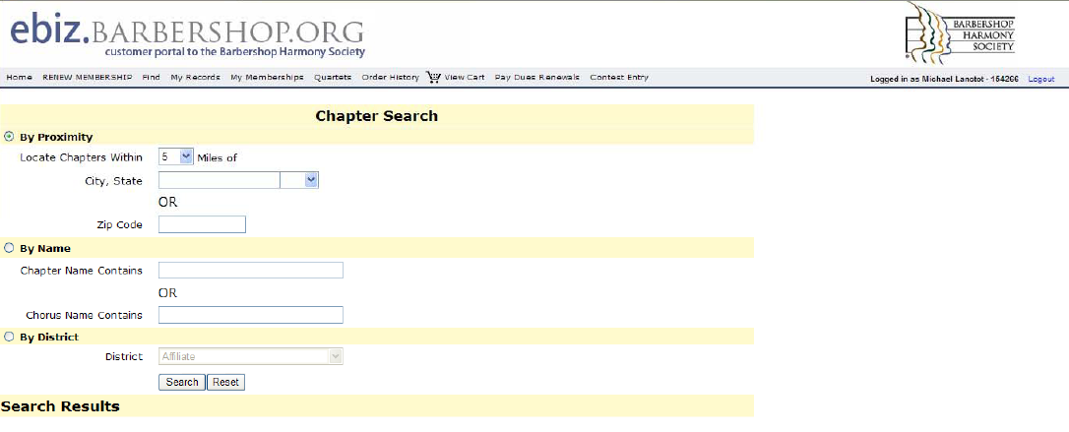
EBIZ PAGE – FIND A CHAPTER
TIPS
INTUITIVE APPROACH TO FINDING A SPECIFIC CHAPTER
YOU CAN OBTAIN A LIST OF ALL CHAPTERS IN A SPECIFIC GEOGRAPHIC AREA OR DISTRICT
USE OF PARTIAL “KEY WORDS]” IN NAME OR NICKNAME OF CHORUS IS OKAY.

Slide 79
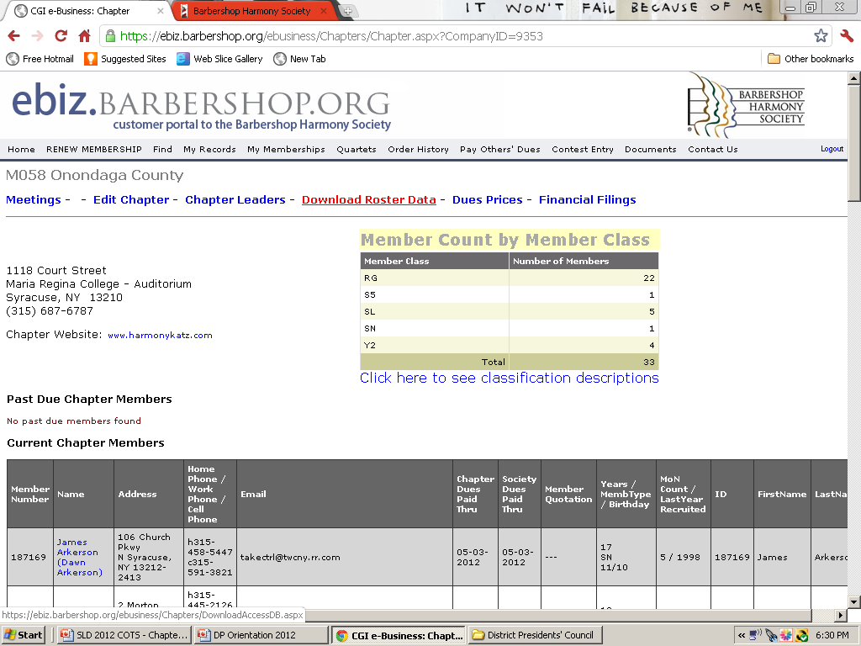
EBIZ PAGE – PULLING YOUR ROSTER
TIPS
ONCE ON YOUR CHAPTER’S PAGE CLICK ON ‘DOWNLOAD DATA’

Slide 80
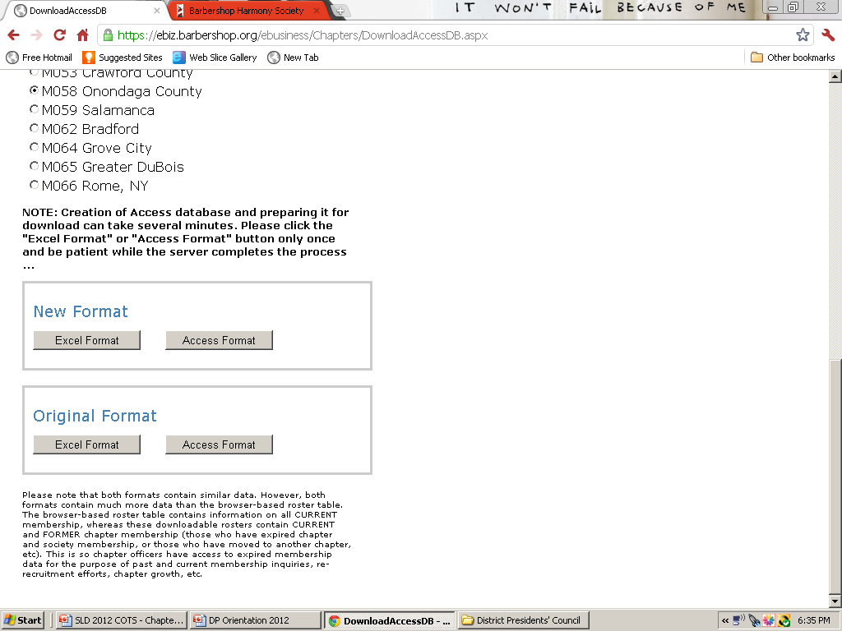
EBIZ PAGE – PULLING YOUR ROSTER
TIPS
CLICK ON YOUR FORMAT (EXCEL OR ACCESS)
THE FILE WILL DOWNLOAD TO YOUR COMPUTER
THE DATA IS IN RAW FORM AND WILL REQUIRE
SOME CLEANING UP FOR USE. BUT
EVERYTHING YOU NEED TO KNOW IS THERE.

Slide 81
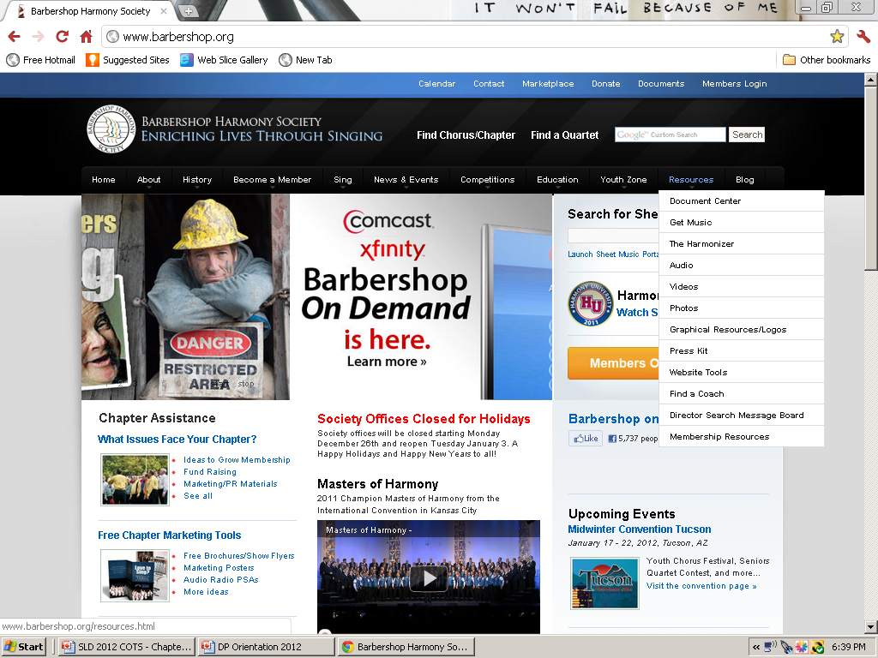
SOCIETY WEB PAGE – DOCUMENT CENTER

Slide 82
SOCIETY WEB SITE WWW.BARBERSHOP.ORG
DOCUMENT CENTER
DOES NOT REQUIRE PASSWORD TO ACCESS.
PROVIDES ACCESS TO FORMS AND DOCUMENTS IN WORD OR PDF FORMAT
ACROBAT READER FOR PDF FILES IS DOWNLOADABLE TO YOUR COMPUTER AT NO CHARGE
MANY MANUALS AND BOOKLETS ARE
DOWNLOADABLE TO YOUR COMPUTER/PRINTER ON THIS SITE.
EBIZ FOR MEMBERS
DOES REQUIRE PASSWORD TO ACCESS.
PROVIDES ACCESS TO REPORTS, LISTS AND
SPECIALTY ENTRY/REGISTRATION FORMS
OF SPECIFIC IMPORTANCE TO THE CHAPTER SECRETARY.
PROVIDES ACCESS TO MEMBER PROFILES THAT CAN BE UPDATED BY THE MEMBER
OR CHAPTER SECRETARY. A VERIFICATION POSTING SENT AFTER EACH PROFILE IS
UPDATED TO CS AND MEMBER.

Slide 83
CERTIFICATION OF SONGS SUNG AT CONTEST
SUBMITTED AS PART OF CONTEST ENTRY PROCESS
CHAPTER SECRETARY CERTIFIES THAT SONGS AND ARRANGEMENTS ARE LEGAL ACCORDING TO COPYRIGHT LAW.
SUBMITS SONG TITLES, COMPOSER, ARRANGER AND PROOF THAT SONGS WERE PURCHASED LEGALLY AND ARRANGER WAS PAID FOR SERVICES
RE-ENTERS CONTEST ONLINE IF THE SONGS CHORUS PLANS TO SING CHANGE.

Slide 84
CONTEST REGISTRATION
CONTEST ENTRY ON E-BIZ
CONTEST ENTRY FORM IS COMPLETED ONLINE AT WWW.EBIZ.BARBERSHOP.ORG
ENTRY IS AUTOMATICALLY SENT TO THE DISTRICT REPRESENTATIVE OF CONTEST AND JUDGING FOR YOUR DISTRICT, THE CONVENTION GENERAL CHAIRMAN AND THE CONTEST CAS
THERE IS A DEADLINE FOR SUBMISSION OF THE CONTEST ENTRY FORM (CJ20) AND IT VARIES FROM DISTRICT TO DISTRICT. CONTACT YOUR DISTRICT REPRESENTATIVE OF CONTEST AND JUDGING FOR THE DEADLINE AND SPECIAL RULES.

Slide 85
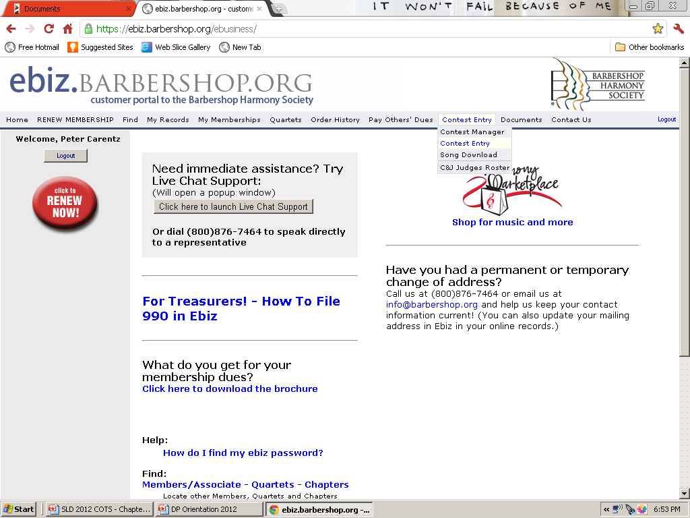

Slide 86
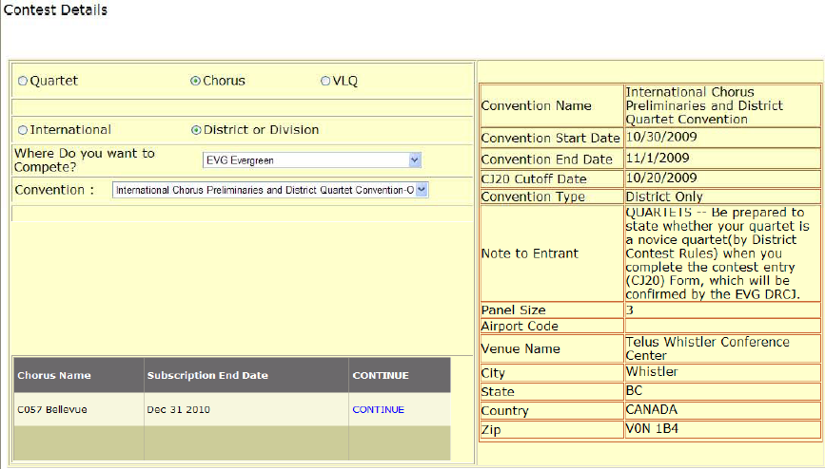
CONTEST ENTRY PROCESS

Slide 87
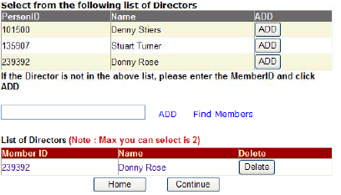
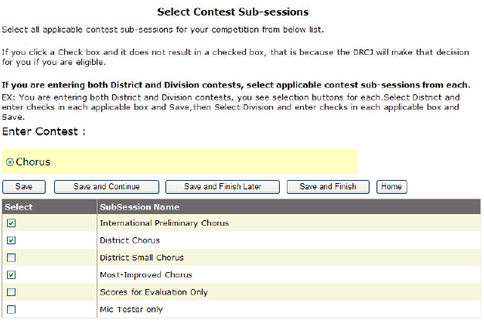
CONTEST ENTRY PROCESS

Slide 88
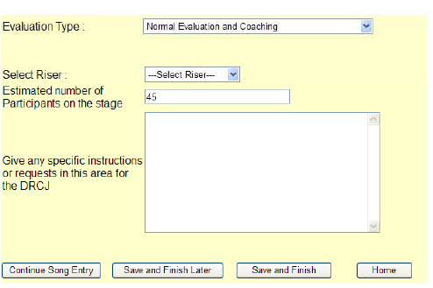
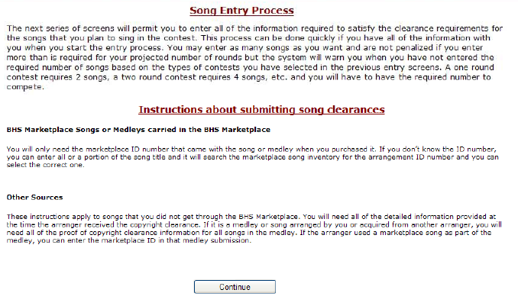
CONTEST ENTRY PROCESS

Slide 89
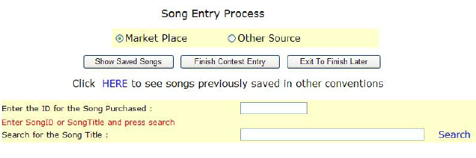
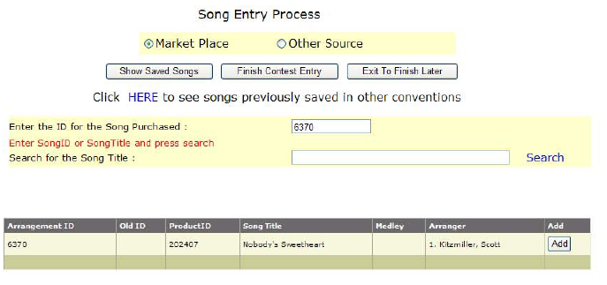
CONTEST ENTRY PROCESS

Slide 90
CERTIFICATION OF PAID-UP MEMBERS AT CONTESTS
IT IS VITAL THAT THE CHAPTER SECRETARY IS ABLE TO DETERMINE AND CERTIFY THAT EACH MEMBER OF HIS COMPETING CHORUS IS A PAID-UP MEMBER OF THE SOCIETY.
THIS IS ESPECIALLY CRITICAL WHEN A MEMBER’S RENEWAL COMES DUE IMMEDIATELY PRIOR TO THE SPRING, FALL OR INTERNATIONAL CONTESTS.
PENALTIES FOR HAVING NON-MEMBERS OR NON-PAID-UP MEMBERS SINGING AT A CONTEST MAY BE SEVERE, UP TO AND INCLUDING DISQUALIFICATION OF THE CHORUS.

Slide 91
AN EASY WAY TO ENSURE EVERYONE’S MEMBERSHIP IS CURRENT… EBIZ

Slide 92
ROLE OF CHAPTER SECRETARY IN GRANT WRITING PROCESS
MEMBER OF THE GRANT WRITING TEAM
RESOURCE FOR GATHERING INFORMATION FOR THE TEAM AND HELPING TO KEEP THINGS ORGANIZED
PROVIDE INPUT, AS NEEDED
PROVIDE PROOFREADING SUPPORT
PROVIDE SUGGESTIONS FOR PRESENTATION OF THE FINISHED PRODUCT TO THE GROUP PROVIDING THE GRANT
PROVIDE FOLLOW-UP SUPPORT AND LIAISON BETWEEN THE CHAPTER AND THE FUNDING GROUP.

Slide 93
GATHERING THE TEAM
SEEK DIRECTION FROM THE CHAPTER BOARD. HAVE A REALISTIC GOAL!
KEEP THE TEAM SMALL IN NUMBER.
GATHER A DIVERSE GROUP OF MEMBERS WHO COULD WORK WELL TOGETHER.
  LEADERS WITH COMMON SENSE AND CAN MOTIVATE THE TEAM.
  VISIONARIES THAT CAN SEE AND SEEK THE POSSIBILITIES HOW A GRANT MAY ASSIST THE CHAPTER AND ALSO PROMOTE OUR HOBBY.
  WRITERS WHO CAN PREPARE A DOCUMENT FOR PRESENTATION TO THE FUNDING AGENCY
  FRONT MEN WHO CAN INTERFACE IN A POSITIVE WAY WITH THE AGENCY
  PROOFREADERS THAT CAN PICK APART THE DOCUMENT THAT WILL NEED TO BE PREPARED
SEEK “WORKER BEES” THAT WILL COMMIT TIME AND EFFORT TO THE PROJECT.
SEEK THOSE WITH THE QUALITIES YOU SEEK FOR THE PROJECT – DON’T ASK FOR VOLUNTEERS, PERSONALLY ASK THOSE YOU WANT!
PROVIDE A POSITIVE WORK ENVIRONMENT.
FIND MEMBERS THAT ARE POSITIVE ABOUT THE OUTCOMES.

Slide 94

WHAT ARE YOU TRYING TO ACHIEVE?
IT’S NOT ABOUT $$$$, BUT ABOUT BUILDING A REPUTATION AND A RELATIONSHIP!
THERE IS NO FREE LUNCH – YOU MUST OFFER SOMETHING OF VALUE IN RETURN.
THE FUNDING AGENCY MUST LIKE YOU.
YOU MUST LIKE THE FUNDING AGENCY.
YOU MUST BE FLEXIBLE.
YOU MUST REACH A WIDE GROUP OF PEOPLE.
YOU MUST SHOW A RETURN FOR THE FUNDING AGENCY… IT’S NOT ABOUT THE $$$$

Slide 95

PREPARING THE GROUND WORK FOR A SUCCESSFUL PROJECT
IDENTIFY POTENTIAL FUNDING AGENCIES.
RESEARCH THE FUNDING AGENCIES.
LEARN WHEN THE FUNDING AGENCY DECIDES ON POTENTIAL GRANT APPLICATIONS.
MEET WITH THE KEY PEOPLE IN THE SELECTION PROCESS.
EXCEED WHAT THE FUNDING AGENCY IS SEEKING.
LISTEN TO THE CUSTOMER (THE FUNDING AGENCY).
FOLLOW-THROUGH ON WHAT YOU PROMISE.
SEEK FEEDBACK FROM OTHERS TO IMPROVE.
SELL WHAT YOU DO BEST… BARBERSHOP SINGING.

Slide 96

TOOLS NEEDED FOR GRANT WRITING
SOCIETY/HF GRANT WRITING HANDBOOK.
LIBRARY BOOKS ON GRANT WRITING
LIST OF POTENTIAL GRANT FUNDING RESOURCES AND LEADS
APPLICATION FOR THE GRANT
COMPUTER FOR WORD PROCESSING
LOCATION TO MEET REGULARLY AND DEVELOP THE PROPOSAL.

Slide 97

WHAT NOT TO DO!
DON’T PROCRASTINATE… SET AND MEET YOUR DEADLINES AND THOSE OF THE FUNDING AGENCY.
SUBMIT A GRANT PROPOSAL WITH TYPOS.
SUBMIT A GRANT PROPOSAL NOT MEETING THE SPECIFIC GOALS AND STANDARDS OF THE FUNDING AGENCY.
DON’T JUST ASK FOR $$$. SHOW THE FUNDING AGENCY HOW YOU PROPOSE TO EARN THE GRANT MONEY BY DOING SOMETHING THAT ENHANCES THE FUNDING AGENCY’S IMAGE IN THE COMMUNITY.
ALWAYS GIVE SOMETHING IN RETURN FOR THE GRANT MONEY.

Slide 98
WHAT TO DO!
BUILD RELATIONSHIPS EVERYWHERE.
CONNECT BARBERSHOP SINGING WITH THE FUNDING AGENCY… IT’S LIKE APPLE PIE AND MOTHER.
PROMOTE BARBERSHOP SINGING, BUT ALSO PROMOTE THE FUNDING AGENCY.
GET INVOLVED WITH THE ARTS COMMUNITY… CAST BREAD ON THE WATER.
ENHANCE YOUR VISIBILITY IN THE COMMUNITY.
READ AND BONE-UP ON GRANT WRITING
START SMALL WITH YOUR PROPOSAL, BE SUCCESSFUL, AND PROMOTE A LARGER PROPOSAL NEXT TIME.
FOCUS ON THE ARTS AND YOUTH… THAT’S HOT

Slide 99

WHAT HAPPENS IF WE DON’T GET THE GRANT?
FIND OUT WHY… ASK FOR FEEDBACK AS TO WHY YOUR PROPOSAL WAS REJECTED.
KEEP TRYING AND IMPROVING THE PRODUCT.
REFINE YOUR PRESENTATION.
FEW ORGANIZATIONS GET GRANTS THE FIRST TIME AROUND, KEEP TRYING.
CONTINUALLY IMPROVE YOUR STANDING IN THE LOCAL COMMUNITY AND THE ARTS COMMUNITY.
WORK FOR FREE AS AN ENTRE FOR FUTURE FUNDING OF YOUR PROJECTS.
BUILD RELATIONSHIPS! KNOW THE PEOPLE YOU’RE TRYING TO GET A GRANT FROM.
DON’T EVER GIVE UP

Slide 100





