Slide 1
Marketing & Public Relations
FWD LEADERSHIP ACADEMY
2013 Sun Harbor
Christmas Show Promotion
North Pole Express!

Slide 2
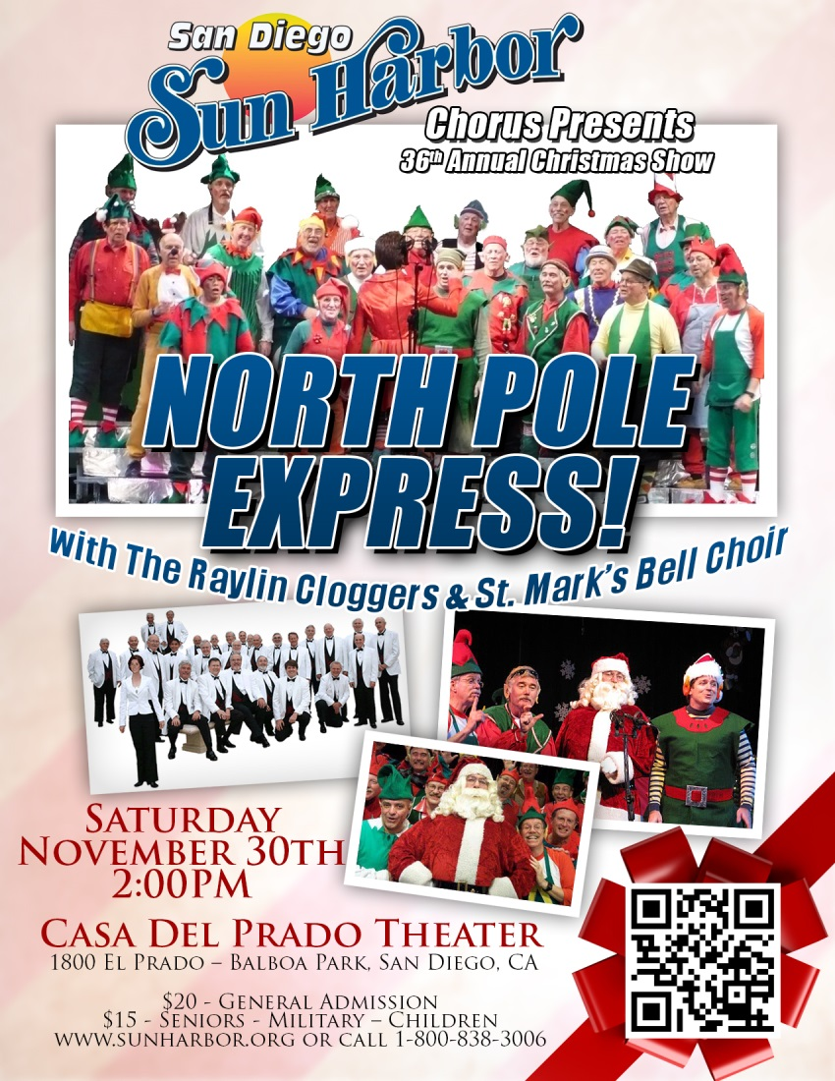
Flyers – 250 - 8.5x11 & 250 Postcard
$96.11

Slide 3
2,782 Postcards via Vista Print
$1,251.73

Slide 4
Email Blast – SDPAL (13,000)
ArtTix – Ticket Booth – Online presence

Slide 5
Email Blast – Chorus file (550)

Slide 6
ArtTix – Weekly Email and Calendar
13,000 addresses

Slide 7
Local Club Newsletters and Meetings
In Conjunction with Membership
Flyers and Quartet
  Rotary
  Lions Club
  Seniors Social Club

Slide 8
Guest Performers
Cloggers & Bell Choir
Publicity
Flyers
50 tickets to sell or give to “their” people.
  Increases exposure to a different group.
  Fills seats
  Sell more tickets if exceeds 50

Slide 9
Donated Tickets
USO
  50 Tickets given out at Thanksgiving Dinner
    Supports our Charity Mission
    Fills Seats
    Feels good
Some Chapters have encouraged businesses or clubs to underwrite Tickets for Donation.

Slide 10
BrownPaperTickets.com
“Brown Paper Tickets is the smartest way to sell tickets for your next event! Ticket buyers pay just $0.99 + 3.5%, including delivery and credit card processing!” (from website)
Always free to create events and sell tickets.
Live in-house 24/7 phone sales and support.
Free ticket printing and shipping for your ticket buyers.
Assists with online marketing.

Slide 11


Facebook.com event page
North Pole Express!
Online presence
Easy way to pass on to Friends of Chapter Members and they pass on and they pass on and . . . . . . .

Slide 12
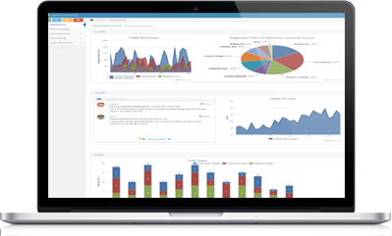
GetPromotd.com
Event marketing made easy.
Tools for advertising, promotions, analytics and more.

