Slide 1
Marketing & Public Relations
FWD LEADERSHIP ACADEMY
Adapted for 2015 Leadership Academy
from presentations by Craig Hughes,
DVP2 – FWD, and BHS

Slide 2
Marketing, Promotion,
Public Relations & Publicity
If the circus is coming to town and you paint a sign saying, "Circus is coming to Fairgrounds Sunday," that's Advertising.
If you put the sign on the side of an elephant and walk him through town, that's a Promotion.
If the elephant walks through the Mayor's flower bed, that's Publicity.
If 12 clowns show up in a VW to replant the flowers and the Mayor laughs about it and photographers record it, that's Public Relations.
If you planned the whole thing, that's Marketing!
-- Author Unknown

Slide 3
Recommended Activities:
Form a committee to assist you in carrying out your responsibilities
Create promotional materials
Work with outside vendors such as graphic designers, printers and photographers
Make sure all communications reflect the standards and mission of the chapter and society
Prepare and distribute all communications/promotional materials:
  News releases
  Chapter/District bulletin stories as needed
  Flyers
  Posters

Slide 4
Recommended Activities:
Attend Leadership Academy and, when possible, other training seminars
Develop a public relations/marketing plan
Build relationships between chapter and:
  Media
  Local community, civic organizations
  Other society chapters

Slide 5
Components of a Basic Marketing Plan
Executive Summary (prepare this last)
Chapter Mission Statement (typically focused on present business scope -"who we are and what we do")
Situational Analysis (where are you now?)
Goals and Objectives
Tactics to achieve the objectives

Slide 6
Information Resources
  Society (online) http://www.Barbershop.org
  Sign up for Livewire
  District http://www.farwesterndistrict.org
  People
  Internet Links
  Leadership Academy
  Harmony University
  Podcasts www.itunes.com

Slide 7
Build Your Marketing Team
Assemble talent to compliment your skills
Consider the skills needed in your job
Who in your chorus has those skills?
Are their some outside the chorus that you can bring in?
Make a list now of needs and possible team members
Notes:
Metrics are at the heart of a good, customer-focused process management system and any program directed at continuous improvement. The focus on customers and performance standards show up in the form of metrics that assess your ability to meet your customers' needs and business objectives.
"Specific“
in that your metrics are specific and targeted to the area you are measuring. For example, if you are measuring customer satisfaction, a good metric would be direct feedback from customers on how they feel about your service or product. A poorer metric would be the number of returned products or number customer complaints. While direct "internal" measure, they are indirect measures of customer satisfaction and, as such, can be misleading and produce unwanted surprises later on. "Measurable" in that you can collect data that is accurate and complete.
"Actionable“
in that the metrics are easy-to-understand, and it is clear when you chart your performance over time which direction is "good" and which direction is "bad", so that you know when to take action.
"Relevant“
simply means don't measure things that are not important. A common downfall of process professionals or standards groups is to measure everything, which produces many meaningless measures.
"Timely“
metrics are those for which you can get the data when you need it.
Metrics should be simple. If they require a lot of explanation and definition, then collecting data, and translating that data into actions becomes more difficult. Easy-to-understand metrics are easier to sell, and have a stronger impact on the process and the people who us it.

Slide 8
Tools of the Marketing Trade
You and your team are the chief money earning element of your chapter.
These are the people, materials and techniques that will help you do your job.

Slide 9
Tools of the Trade
COMMUNICATIONS – Developing a public presence
WEBSITE – Outreach to the community and essential communications tool for the chorus.
FACEBOOK PAGE – Facebook is a virtual afterglow for the chorus, your fans, family and friends. Post informal photos and invitations to events.
EMAIL ADDRESS
EMAILED information to your mailing list
VOICE MAIL – Set this up for Singing Valentines, show tickets, and whenever demand would make this a good idea.

Slide 10
Tools of the Trade
What should be on your computer
MS Office: Word processing, spreadsheets, PowerPoint
Adobe Creative Suite: InDesign for page layout, PhotoShop for digital photo creation and processing, Illustrator for vector art, and ad creation, and Acrobat for creating PDFs.
iTunes or other music library software for creating and duplicating learning tracks
Helpful apps: Music Converter Pro, Pitch Pipe
File sharing, backup Cloud-based apps Dropbox, Google Drive, iCloud

Slide 11
Social media overview
The Power of Social Media
Top social media websites

Slide 12
Social media tools
Google+, Gmail, Drive, Forms, Calendar, Maps
Dropbox: File backup and sharing
Facebook: Social bonding and outreach
YouTube: Video content deposits and withdrawals
Mailchimp, Acymailing: Free email blasts, ad
Lynda.com: How-to instruction

Slide 13
Chapter websites
Public facing
  Contact us… find us… hire us… learn more
  General image and recruiting
  Publicity and ticket orders
Internal facing
  Internal communication, administration, chapter management functions

Slide 14
5 things a public-facing website should have
Faces!
  What’s a good picture?
  Action (candid) vs. staged/posed
Value proposition: Why you should see us, hear us, sing with us
Come see us
Contact info
Map to meeting: create own or use MapQuest or others

Slide 15
Internal Communications
Direct email
  Maintain everyone in simple list – manage updates using Members Only (Groupanizer)
  Best for small numbers
  Email management applications
Yahoo groups, etc.
  Free… easy… members maintain themselves
Weekly bulletin
  Constant reinforcement of basics, schedule, changes
  Chorus calendar (Google Calendar)
    Links to website
    Allows for notifications

Slide 16
How Members can help Marketing
Every member is an ambassador of your chapter
Give them the tools to help promote your chapter
  Show posters
  Active Business Cards
  Logowear or pins (I Sing)
  Email promotions for their friends

Slide 17

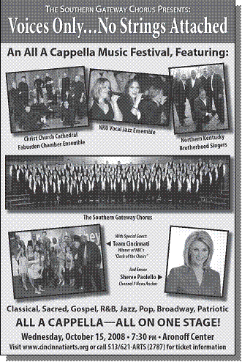
Expand your public
Partner with other arts groups
Join your local arts council
Help with charitable events

Slide 18
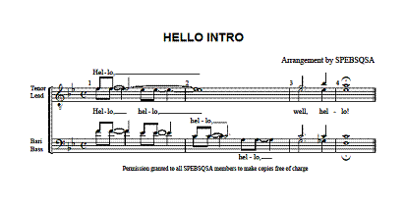
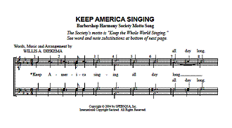
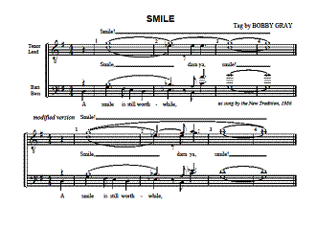
Get buy-in from schools
Demo a public domain song or tag
Use a young quartet
Present the Chorus Director with copies

Slide 19
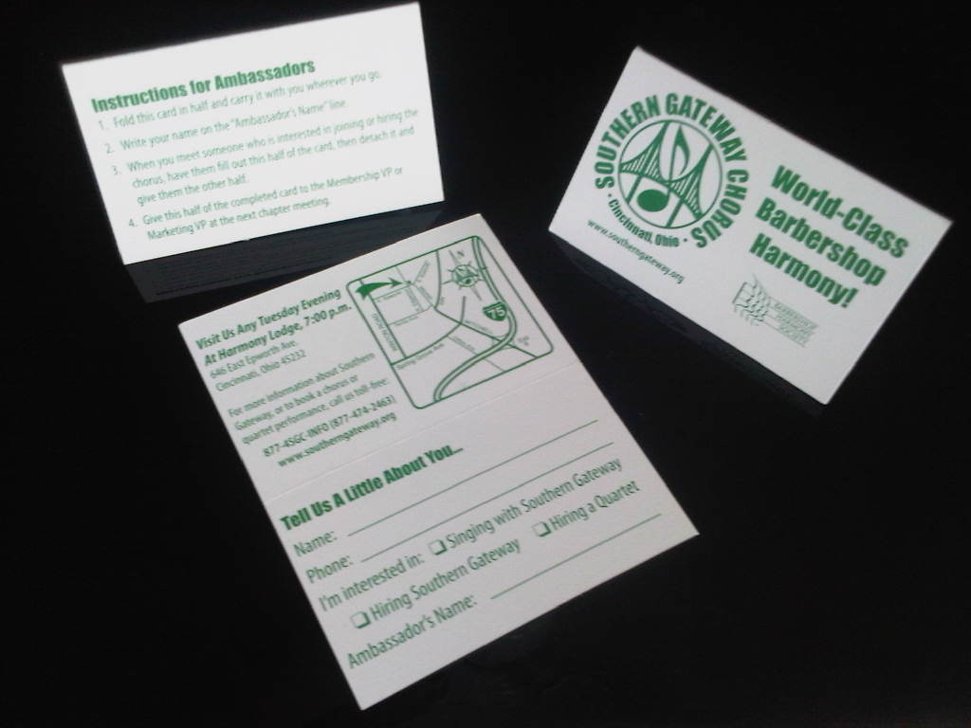
Active Business Card
Two parts
  Traditional business card information
  Follow-up information for you

Slide 20
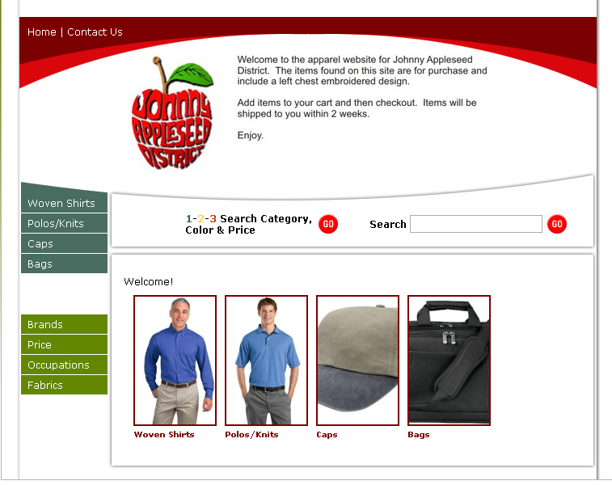
Give people a reason to ask
Wear your chapter’s logo
Carry your music
Sing in public (not just in the shower)

Slide 21
Group Question
Is the brand you present to the public centered around being the XYZ chapter of the Barbershop Harmony Society or do you build your brand around the chorus name, or both?
Also, do you bill yourself as a Barbershop group or as a male chorus?

Slide 22
Arrange for Public Performances
Surf websites
Send a proactive email
Follow-up with a phone call
Follow-up with direct mail piece
Join the Chamber of Commerce and/or CVB
Seek highly visible appearances (national anthems)
Offer incentives to membership to secure a performance
Develop relationships with talent agents in the area
Notes:
Surf website of organizations that host public events and send them a proactive email, follow-up with a phone call or direct mail piece
Join the Chamber of Commerce and/or Convention and Visitors Bureau in your community and look through the annual calendar of events for contact information for the organizers. Send them a proactive email, follow-up with a phone call or direct mail piece
Make highly visible national anthem appearances at local sporting events to make an impression on potential clients.

Slide 23
Singing Valentines
Why?
  Easy source of funding
  Tried ‘n’ true methodology
  Community minded program
  Experience one-on-one
  Many chapters’ sole fundraising project
  Novelty of performing in business
  Total chapter involvement for short period of time
  Consider telephone messages vs. in-person

Slide 24
Donors & Sponsorships
Chapters enjoying the most success in fundraising tend to be very involved in their community, operate with a purpose and are focused on serving others. A chapter with the single focus of singing well will have a harder time making their message resonate with potential funding sources.
Create benefit package (promotions, bulletins, mailings, mention in news releases, etc)
Guidelines for chapter fulfillment of benefits
Start with chapter members and their employers
Newspaper thank you ads for other donors

Slide 25
Performing Arts Grants
Chapters enjoying the most success in fundraising tend to be very involved in their community. Potential grant resources will often be interested in the mission and vision of the chapter as well as an understanding of the chapter’s budget and planning process.
Researching in library
Specific guidelines to follow
Checking newspaper articles and other organizational funded
Check newspaper thank you advertisements for donors
Check or partner with Community Foundations

Slide 26
Tools of the Trade - Marketing
OTHER TOOLS
Mailing lists (accurate and updated)
  all past booking contacts
  media contacts
  Vocal music educators
  Ticket buyers
  Advertisers
  Signing Valentines clients
PRESS KIT- Design a slick PR kit that tells them who you are, what you do, and why they should hire you.

Slide 27
Customer Mailing Lists
Why?
  Easier on chapter members vs. one-on-one asking
  Can do more by mail than personal visits
  Exchangeable with symphony, theater, and other similar client mailing lists

Slide 28
Customer Mailing Lists
Develop a special database
Find someone other than a member to maintain
Mailing lists (accurate and updated)
  past booking contacts
  media contacts
  Vocal music educators
  Ticket buyers
  Advertisers
  Signing Valentines clients

Slide 29
Public Relations – placing stories
What’s Interesting To The Media?

Slide 30
Developing stories for the media
Decide why you want the coverage
Know what’s newsworthy
Develop a hook
Define your approach
Determine your targets
Notes:
An angle is what makes a news story possible. Asking yourself “Who cares?” and “Why would they care?” is a good place to start. Ask yourself “If I didn’t know anything about this event, would I care?” If not, “What would make me care? Why would it matter?” The event on its own may not be newsworthy, but perhaps someone attending or participating may provide you and angle.

Slide 31
Human Interest Stories
Youth
Senior Participation
Multigenerational stories
Surprise
Excite
Significant milestones
Feel Good – Human interest

Slide 32
Achievements By Locals
Awards received
  Successful contest participation
  Grants & support received
Performance at…
  Interesting place
  Interesting audience
Events attended
  Conventions
  Contests
  Educational experiences

Slide 33
Study the publications
Learn what you can about publications
Learn about the writers
Learn about the mission of the publication

Slide 34
Print Media
Free Papers & Newsletters
Weekly Newspapers
Daily Newspapers
Magazines
Direct Mail
Posters & Flyers

Slide 35
Face-To-Face Meetings
Hand them your material if you can
If you cannot meet them to hand over material
  Follow up by telephone
  Follow up by email
If you cannot meet the person sought, meet their associate or assistant
  Harder to ignore submission if personal
  Opportunity to answer questions

Slide 36
Public Relations Tools
News release - How to write one
Keep it to one page
Contact information about your group at the top
The who, what, when, where and why of your story
The date this information is appropriate for release
Notes:
An angle is what makes a news story possible. Asking yourself “Who cares?” and “Why would they care?” is a good place to start. Ask yourself “If I didn’t know anything about this event, would I care?” If not, “What would make me care? Why would it matter?” The event on its own may not be newsworthy, but perhaps someone attending or participating may provide you and angle.

Slide 37
Public Relations Tools
News release - How to write one
A headline and summary of what this story is about
A short bio on your organization
Describe photo opportunities that may exist
A “###” symbol at the end denotes the end of the release
* press releases are routinely ignored by the media.
Notes:
An angle is what makes a news story possible. Asking yourself “Who cares?” and “Why would they care?” is a good place to start. Ask yourself “If I didn’t know anything about this event, would I care?” If not, “What would make me care? Why would it matter?” The event on its own may not be newsworthy, but perhaps someone attending or participating may provide you and angle.

Slide 38
Public Relations Tools
Sending News Releases
  Who do you send a news release to?
    City editor (Newspaper)
    News editor or publisher (Community paper)
    Assignment editor (TV)
    News director (Radio)
  How to distribute
    Email
    Mail
    In person (the best way)
Notes:
An angle is what makes a news story possible. Asking yourself “Who cares?” and “Why would they care?” is a good place to start. Ask yourself “If I didn’t know anything about this event, would I care?” If not, “What would make me care? Why would it matter?” The event on its own may not be newsworthy, but perhaps someone attending or participating may provide you and angle.

Slide 39
Public Relations Tools
Media kit (only helpful after media has agreed to cover your event)
  Components
    News release
    Fact sheet or brochure
    High res, quality digital photos with identifying captions and photo credit
    Copies of previous articles written about your group
  How to distribute
    In person, by email, on website
Notes:
An angle is what makes a news story possible. Asking yourself “Who cares?” and “Why would they care?” is a good place to start. Ask yourself “If I didn’t know anything about this event, would I care?” If not, “What would make me care? Why would it matter?” The event on its own may not be newsworthy, but perhaps someone attending or participating may provide you and angle.

Slide 40
Best Ways to Approach the Media
Determine Your Targets
Tell the media what you're doing and why.
Future stories, not accomplishments.
You will not get very far without a creative or unique angle
5Ws & How
Notes:
Targeting media outlets
When you put together an advertising plan, you need to select those media most likely to reach your customers. The same holds true when you decide which media to contact for publicity. Most publications and news shows already have detailed analyses of their audiences, in order to justify their advertising rates. You can get a reader or viewer profile simply by calling or writing to the station or publication and asking for a press kit. Not only will you be able to focus on the medium most appropriate to your audience, but you will also know which types of stories these media use. Once you know, you can tailor your story to fit their format. In addition to the print media, you might find a number of radio and television shows in your area. If you do your homework before you approach the media, and demonstrate to them that you approach your position professionally, you’re someone who knows what works and what doesn't for your audience, you stand a good chance of getting valuable publicity. . . for free.
Communicating with the media
You won't get very far if you try to approach the media with nonessential news without a creative or unique angle. The media deal with unbelievable quantities of information daily, only a small portion of which appears in print or on the air. Don't add to their burden. If an editor or reporter wants more information, he or she will ask for it.

Slide 41
Explore Local Publications
Collect papers sold in community
Read articles about organizations like yours
  Note names of writers
  Note style of writing
  Note content of articles
Clip masthead from each publication
  Note names of staff
  Note names of publisher
  Find them online and bookmark them

Slide 42
Partner with Organizations
Chamber of Commerce
Convention and Visitor’s Bureau
Other Fraternal Groups
Community theatre, band, orchestra
Music venues
Coffee shops, bookstores
Women’s Barbershop groups
Merchant associations

Slide 43
Advertising
Benefits of Advertising (Paid vs. PSA)

Slide 44
Public Service Announcements
Known as PSAs
Free
Wide circulation
Persistent

Slide 45
Paid Advertising
Control of content
Control of timing
Negotiate cost & placement
May lead to free coverage

Slide 46
Radio
Commercial Radio
  Formats deliver specific audiences to your ads
  Create ads that deliver your selling point that includes the sounds of barbershop to a range of audiences
Public radio
  Grant announcements reach a cultural audience

Slide 47
Television
Cable: community access stations, local stations on cable
Broadcast – Local digital stations are an emerging market
Established stations offer PSAs

Slide 48
Print Ads
Daily newspaper
Entertainment and “Milestones” sections
Local, regional tabloids and mags
Cost of print ads is high and readership is shrinking, so is it a good buy?
Don’t forget school publications: monthlies, sports programs, concert programs

Slide 49
Internet Ads
An emerging market
Facebook ads
Go Daddy, etc.
Groupon, Living Social, Here’s the Deal, Sudden Values, etc.

Slide 50
Other Advertising Channels
Internal
Chapter Show Program
FWD Westunes
Harmonizer
Direct mail
Chapter Newsletter (print and/or electronic)

Slide 51
More Advertising Channels
External Chamber Directory CVB Directory Billboard Web Sites Posters Banners at appearances, rehearsal Coasters Bookmarks Business card ads Swapping ads | External Classified Ads www.craigslist.com Take-One box Flyers Email Movie Ads Postcards Media Releases Word of Mouth Brochures In kind advertising
Notes:
These are traditional markets, but which are still viable. Revise.

Slide 52
Expectations
Did we accomplish and meet your expectations for the Marketing & PR class here at FWD Leadership Academy?
Check your “Things to do when I go home lists”

Slide 53
End of this Class, but the
BEGINNING of your success as a “facilitator of change
Go back and make a difference

