Slide 1
Membership
Leadership Academy 2015
Mike Cating

Slide 2
Why are you here?
Name, Chapter, What You Want Out of This

Slide 3
Word’s Getting Out
Deke Sharon: “If you want to learn to sing great a cappella, sing Barbershop.”
Alton Brown: “A good stew is like a great Barbershop quartet: each ingredient is present and blends perfectly.”
Jimmy Fallon regularly singing Barbershop on network TV
A Mighty Wind performing in Bioshock: Infinite
ACDA Partnership

Slide 4
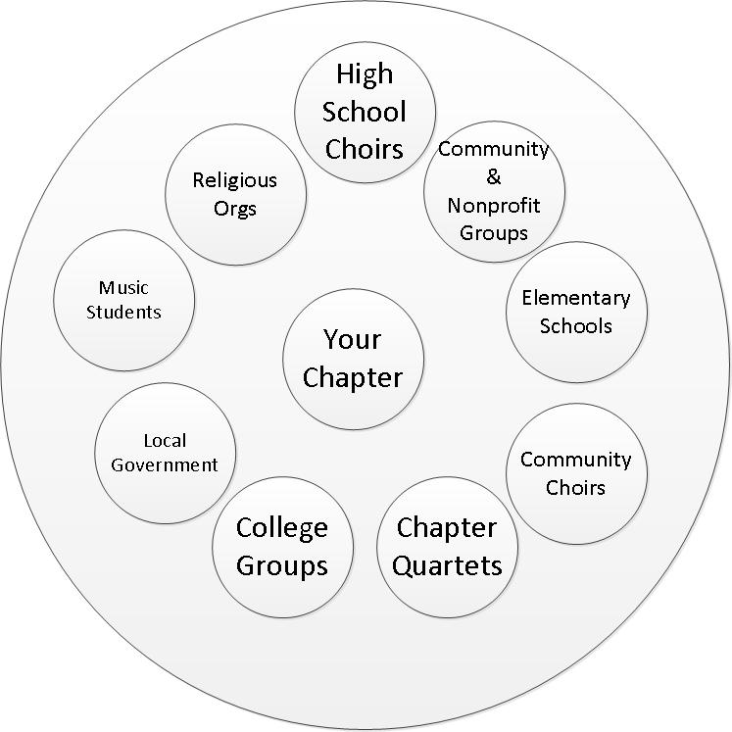
Your Chapter in the Community

Slide 5
Your Community
It’s about sharing your gift – and not expecting immediate gratification!
Build long-lasting relationships with organizations that make a difference in the community
Building relationships builds trust in and visibility for your organization. This in turn builds your perception as a successful organization. People want to belong to successful organizations.
Exercise: What events/activities can we plan to build and strengthen our relationships in the community?

Slide 6
Recruiting vs. Retention
Two sides of the same coin
If you can’t recruit, you can’t replace attrition
If you can’t retain, you can’t grow
Retention is the most important factor in long-term sustainability of the chapter
As Membership VP, you’re crucially responsible for both!

Slide 7
The Membership VP’s Role
You are NOT the guy who does all the recruiting, communicating and retention!
Your responsibility is to construct and execute a successful recruiting and retention plan
  Recruit using all your chapter’s tools (you + all members)
  Ensure your members are enjoying the experience (you + Program VP + Director + Music VP)
  Maintain contact with your alumni (you + Marketing)
  Build relationships in the community (you + Board + Director)
  Maximize the use of your most limiting resource (which is…)

Slide 8
Chapter, Know Thyself!
What is your chapter mission?
  Competition, performance, social, quartet, community, ???
Be true to your mission in all aspects of membership
“Walk the talk”
  Match your audition process to your mission
  Attendance expectations
  Learning tracks, eval tracks, etc.

Slide 9
Part 1: Person to Guest

Slide 10
What got you started on Barbershop?

Slide 11
Who can you recruit?
Guys who previously didn’t have time
  Ex: College student who just graduated
Guys who have taken a break from singing
  Ex: Guy who focused on his children growing up
Former chapter members
Transfers from out-of-town
Guys who sing with someone else
  But what does this do to your relationships with those groups?
  Grow the pie instead of stealing someone else’s piece?
Guys who have never sung in an organization
Split your recruiting efforts to maximize success
  There is no silver bullet to get 20 new guys!

Slide 12
Your Recruiting Arsenal
Your Chorus
Your Members (handout)
Your Director
Your Alumni
Your families and friends
Tag teachers and singers
Chapter Quartets
District and Division Quartets
Invited Performers (ex: headliner quartets)
Your Audience
Your community relationships
Mass Media (ex: video)

Slide 13
“Free Voice Lessons”
6-week program to introduce interested men to a cappella singing
Maximizing the benefit:
Make it a great experience (best teachers, members participate)
Market it everywhere you can
Culminate the program with a graduation show
Think of it as giving back to and sharing your gift with your community

Slide 14
Thoughts on Terms
Barbershop as an “art form” vs. “hobby”
Men’s A Cappella vs. Barbershop
“Glee for Men”

Slide 15
Thoughts on Young Guys
The energy you put into youth in harmony is an investment today that will pay off over 50 years
Scenario 1:
  Option A: I’m going to recruit high school chorus members
  Option B: I will build a long-lasting relationship with the high school music program
Scenario 2:
  Option A: I’m going to recruit college kids
  Option B: I’m going to support and encourage the college glee club by inviting them onto our show

Slide 16
Thoughts on Today’s World
You WILL be Googled. Period.
The smartphone is the most powerful recruiting tool you can imagine.
People are noticing a gap in their personal interactions and sense of community.

Slide 17
Part 2: Guest to Member

Slide 18
The Membership Pipeline
Starts at the moment a guest walks in the door
Ends when the member can no longer be a member of the chapter (death, moving away, etc.)
  REALLY!
Answers the following questions:
  When (and by whom) is a guest communicated with?
  When is a guest asked to become a member?
  What gates must a guest pass to become a member?
  Is there a differentiation between a chapter member and a chorus member?

Slide 19
Guest Turn-offs
“Listen to my story”
“You aren’t learning this tag fast enough”
“You aren’t allowed to sing during this song”
“This song isn’t in the guest book”
“We don’t have a guest book”
“You’re singing this part wrong!”
“We don’t know you, so we won’t talk to you.”

Slide 20
Exercise: Making a guest feel comfortable

Slide 21
Meeting Night Fundamentals
Is every guest greeted at the door by one or more members?
Does every guest get an accurate guest book?
Is every guest’s contact details captured permanently?
Does every guest get added to the chapter’s mailing list?
Does every guest get a personal thank-you email for visiting the chapter? From whom?
Are guests invited to sing on the risers and told when they have to step aside (e.g., for contest run-throughs)?
Are there program activities to make the guests feel welcome?
Are guests encouraged to join the risers if they come late? How?
Are guests appreciated without “showing desperation?”
Do you provide a supportive and encouraging atmosphere for quartets or other small groups?

Slide 22
The Environment You Cultivate
When a guest performs for the group before break, do your members…
A) Rush up at the break and be “helpful” by criticizing every aspect of the performance
B) Cheer and say “Thank you for sharing that gift with us!”
A supportive and encouraging environment improves retention. Period.

Slide 23
Enable your chapter to succeed in Membership
Encourage performances that put your product in front of as many people as possible
Invest in relationships that pay off over years
Share your chapter’s gifts as often as possible
Build a supportive and encouraging environment
Give without expectation
Remember what got you hooked and what keeps you hooked

Slide 24
Part 3: Member to Lifetime Member

Slide 25
What has KEPT you hooked on Barbershop?

Slide 26
Once a Barbershopper, Always a Barbershopper
Polecats
Pseudo-polecats
Tags
Informal singing around rehearsal
Reunion nights
Chapter Shows
Division events (Convention vs. Competition)
Retreats
Social events

Slide 27
What is the effect of competing on your plan?
What is the opportunity cost of competition?
How does competition impact your membership plan?
What is your chapter’s objective in competing?
“Walk the Talk”

Slide 28
Keep the conversation going!
mike.cating@gmail.com
Facebook: Barbershop Enthusiasts
BHS HQ Blog
Ba-acappella mailing list
Share what works – and what didn’t!
Don’t be afraid to try something new
Don’t be afraid of “I’m not interested”

